Slide 1
Go sightseeing: Story
ALUMNAS 3° D:
*Norma Angélica Briones Hernández
N° 5
*Gabriela Anahí Espinoza Rodríguez
N° 11

Slide 2
Go sightseeing: Story
The last year while was in the 2nd year of the school, enter a drawing to win outside the city at South Korea. My parents haven´t wanted give me permission , why they haven´t known the people who accompany me yet,
Upon arrival we were greeted by a girl who asked me:
you have already visited this city?
I haven´t known the country yet, but through documentaries seen some parts of the country
also asked: have you already traveled for business? I Haven´t came for business yet. I have already won the trip at school
The next day at Corea del SurShe
Asked me Have you visited the museum before?
I haven´t gone at museum before
Take you to the museum and then eat
You already have eaten?

Slide 3
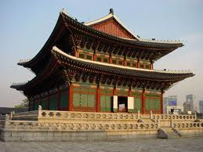

Slide 4
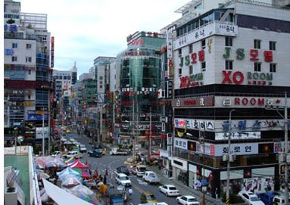
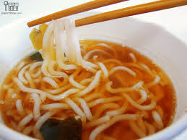
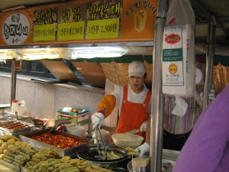
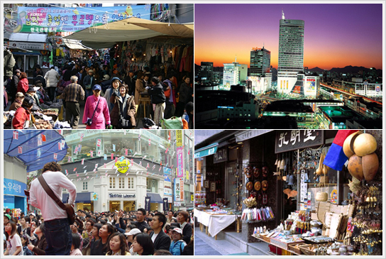

Slide 5
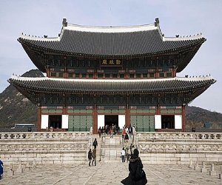
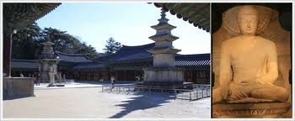
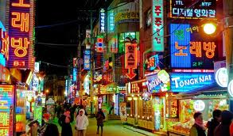

Slide 6
