Slide 1
Escuela normal de educación preescolar
Ingles VI
Proyecto final
Alumna: Ana Cecilia Rico Esqueda
Grado: 3º Sección: B #22

Slide 2
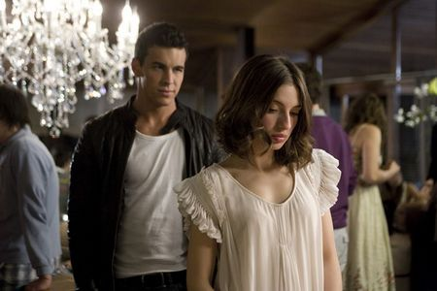
My favorite movie is called Love three meters above the sky, I have seen it like 6 times, I like because it's a different movie to all.
It movie begins with a girl named Babi who had lots of money and had been in the best schools, but one day he met with a guy named H, which have passed very difficult moments along her life and have fought with many men, have had many problems with police.

Slide 3
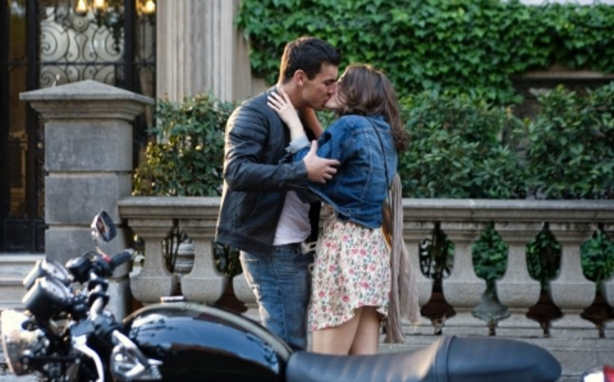
H had a best friend who they have passed a lot of adventures together, for H babi meet was the best thing that have happened, although she was not well. but one day she was slowly falling for him. her family had been very angry, they miss many bad things had to end this relationship.

Slide 4
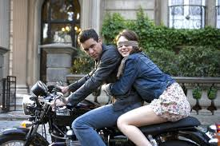
Although they both were very different there was a lot of love, they both had spent time Family unforgettable, but I separate babi, the final of the movie they do not get back together but they never have stopped love.

