Slide 1
English Project
<<My favorite movie>>
Finding Nemo
Name: Ana Gabriela Fernández Vara
Grade: 3°B
Subject: English VI
Teacher: Marlene Muzquiz Flores

Slide 2
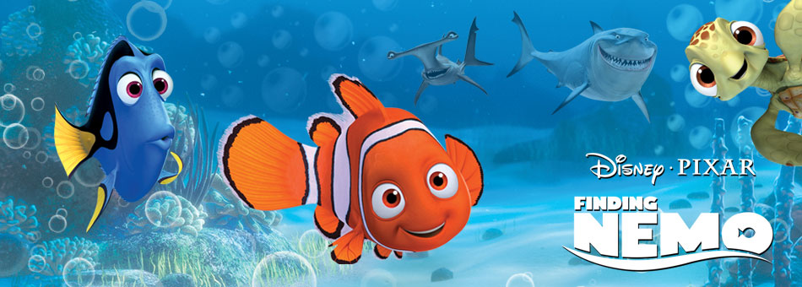
I have seen this movie more tan 20 times.
My family has seen the movie with me
The story tells about a family that has faced a difficult situation.

Slide 3
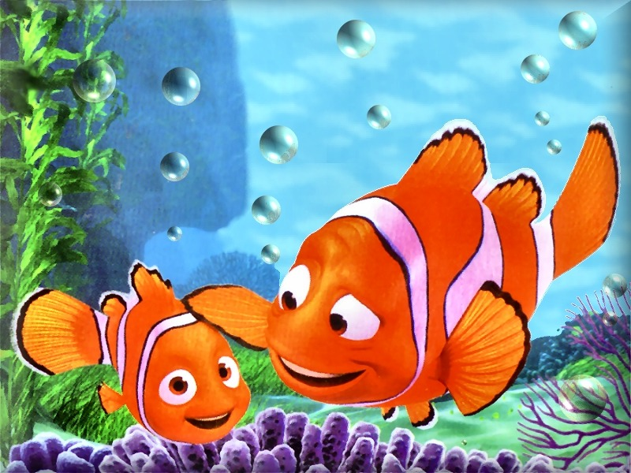
Nemo´s dad has had to face many problems.
Nemo has had to be without mother and brothers because they died.
Nemo´s dad has to take care only

Slide 4
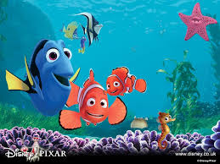
Nemo has been taken by some divers.
Marlin, Nemo´s father, has had to go look for it.
On his trip has found a friend, her name is Dory.
Marlin finally has found his son Nemo.

