Slide 1
Vacations.

Slide 2
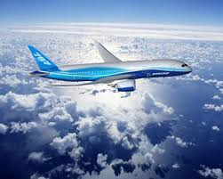
I am planning my vacations to December with my grandmother.
She live in Houston, Texas with my relatives uncle, aunt and my cousin and I am very moved because I don´t know that city and come to think of it I will like knowit.
My father still don´t know if the trip going to be in car o by air mail, he is drearing, estimating the cost and depending from the costs he will take a design.

