Slide 1
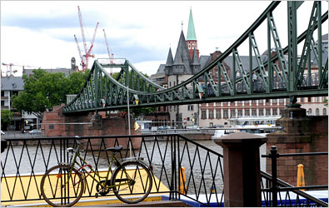
ESCUELA NORMAL DE EDUCACIÓN PREESCOLAR
My life in Germany!
ENGLISH 3
Teacher. Mayela Jimenez
Sofia Elguezabal Esquivel

Slide 2
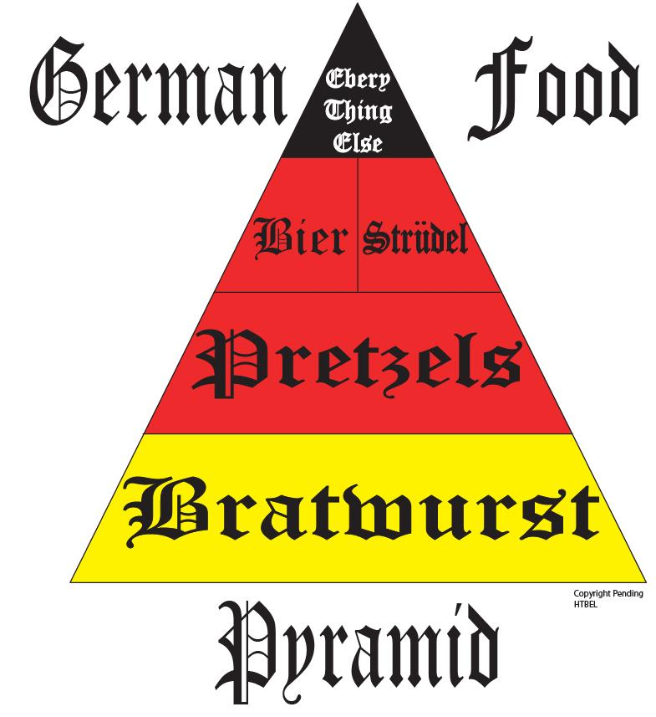
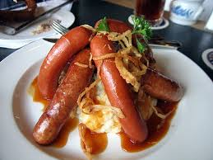
Today I am living in Germany. It is beautiful in here. I love going out with my friends, we usually eat at Frankenmuth Restaurant. They serve the best food in town.

Slide 3
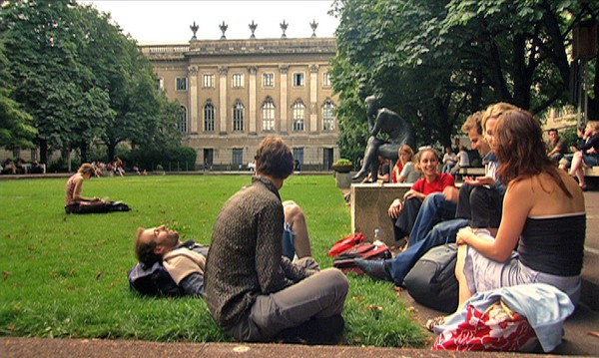
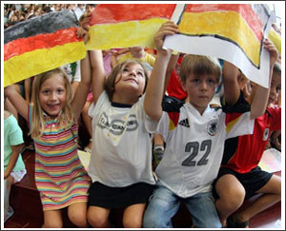
Also, I like to go to school. Right now, I am studying a master degree in education. It is very interesting because we talk about how children are getting into the knowledge nowadays.

Slide 4
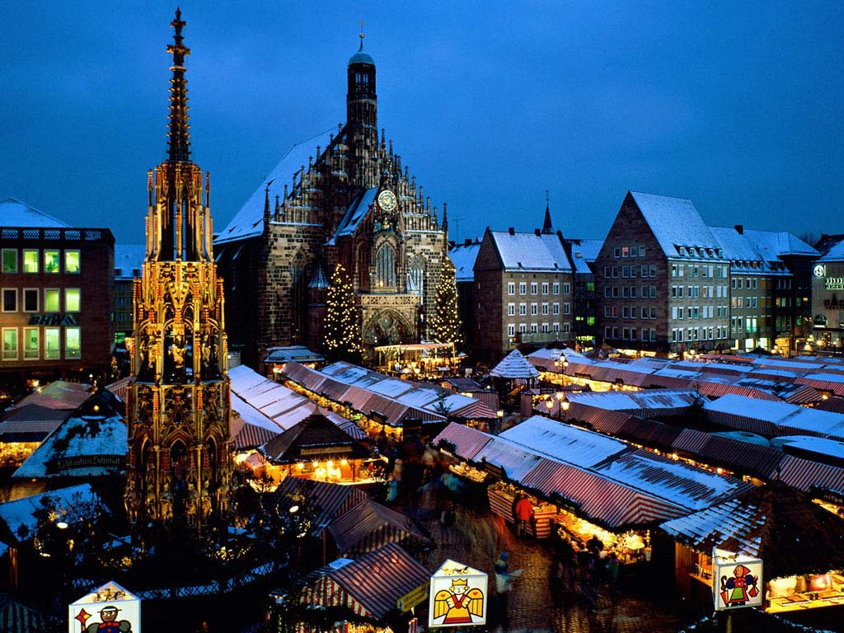
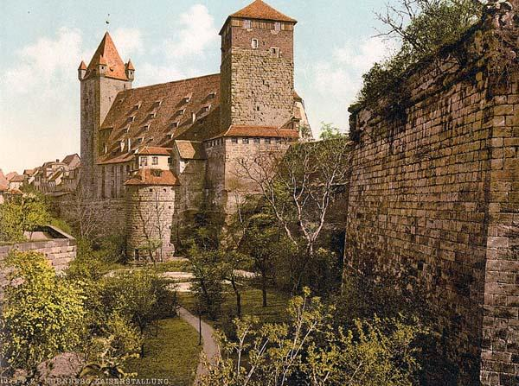
At the University I am meeting a lot of people. We are enjoying the time here. I hope one day you can come visit me because you are going to love it!

