Slide 1
Escuela Normal de Educación Preescolar
“Text”
Name: Dulce María Rodríguez Avalos
Teacher: Marlene Múzquiz
3° B # de Lista: 27

Slide 2
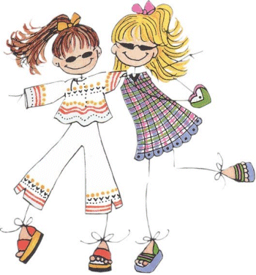
My name is Dulce, I study in the Normal de Preescolar, but right now I meeting of vacations in Morelia, Michoacán, with a friend, your name is Daniela and she study on Facultad de Ciencias de la Comunicación.
We are coming the hotel where we are staying, i'm go to carry luggage to the bedroom while she's getting tourist recommendations on the sights.

Slide 3
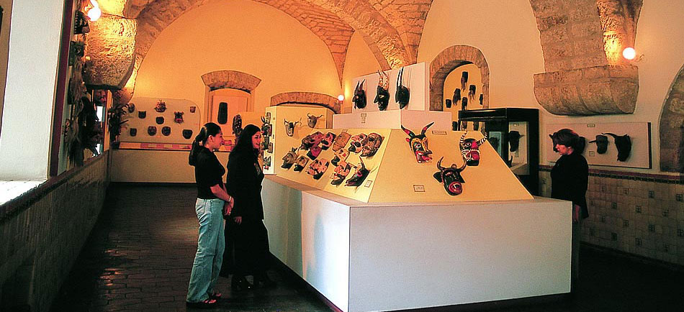
After of sleep a while Daniela and I going to eat a famous restaurant near the hotel, she doesn't buy food with much fat.
At night, we dance in the nightclub, while I’m wanting sing in the karaoke, she want take a moment to meet people.
After of a long day, we arrived the hotel.
The next day, we choose to go to a museum, I doesn’t forget the road return and dialed in a map.

