Slide 1
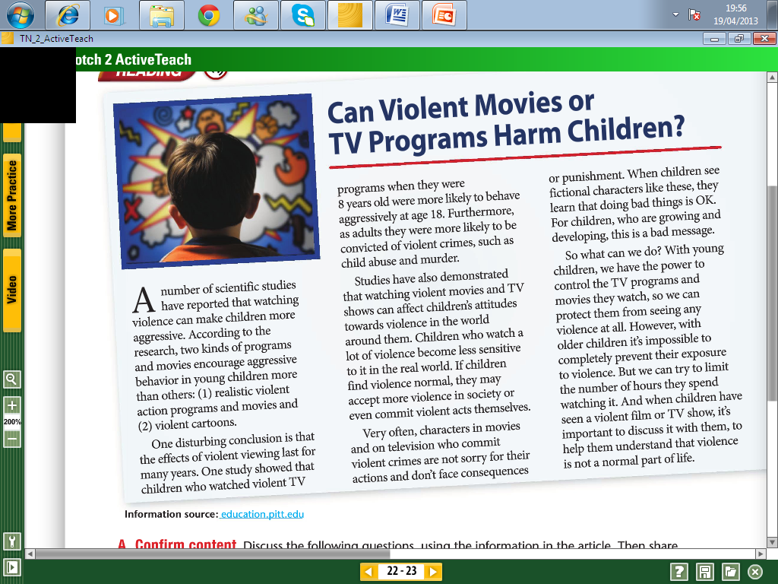

Slide 2
ANSWER SHEET
Excercise A
1.-
2.-
3.-
4.-
5.-
Excercise B

Slide 3
Read the following article about violence in movies Then answer true or false.

Slide 4
1.- Wich of the short movie reviews you think sounds the most interesting and why ?
2.- Write the title of a movie you have seen recently
3.- What genre was it ?

Slide 5
4.- Who stars in the movie, dou you know who directed and produced the movie? 5.- What the movie was about? Use also some adjectives to describe the movie.

