Slide 1
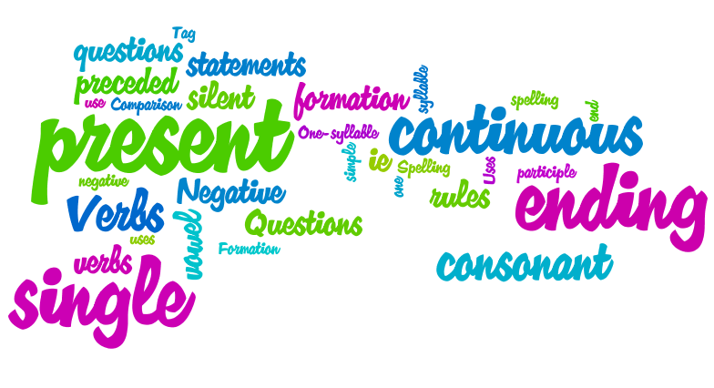
+ Affirmative
Subject | Be | Verb +ING
I | am | driveing
He/She/it | is | eating
We/ You / They | are | playing
- Negative
Subject | Be | Verb +ING
I | am | working
He/She/it | is | travelling
We/ You / They | are | stopping
Spelling rules:
Verbs ending in -e drop –e and ad ing
Vervs ending in –y ad ing
Verbs ending in –l double –l before ending
? Questions
Be | Subject | Verb +ING
am | I | writeing
is | He/She/it | Lieying
are | We/ You / They | running
Verbs with short syllabe ending in vowel and consonant, double the consonant
Verbs ending in –ie drop –ie and add -ying

Slide 2
What are they doing …? (Make short sentences)

Slide 3
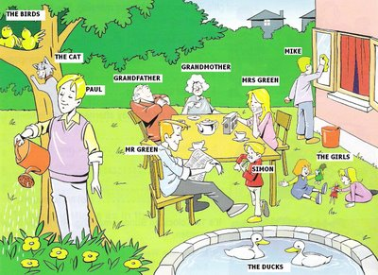
What are they doing …?(In pairs make ? with + or – answers)

