Slide 2
UNDERLINE THE CORRECT ANSWER THAT COMPLETES THE SENTENCE
Q1 - It was _____ so we didn't get it.
expensive enough too expensive enough expensive
Q2 - It's ___ to read; I don't understand it at all.
enough difficult too difficult difficult enough
Q3 - It's not ____ to go to the cinema.
enough late late enough too late
Q4 - It's ____ to pass.
enough difficult too difficult
Q5 - He ate ____ and felt ill.
enough much much enough too much

Slide 3
Answer correctly use the cues from the word bank
1. This computer is _________ to do this calculation.
2. It isn't ___________ to sunbathe.
3. Are you ___________ to reach that shelf?
4. You're ________ to drive.
5. That sweater is big, it's ___________ for you.
6. The garden isn't ____________to play football.
Bigh enough Too big Tall enough
too slow Too young Sunny enough

Slide 4
Fill in the blanks use too or enough on each sentence using the cues on brackets
1) I can't work today. It's ______________. (hot) 2) Tom didn't win the race because his car wasn't ______________. (fast) 3) I'll have to finish it on Friday because I don't have ______________.(time) 4) I can't do this exercise because it's ______________. (too) 5) It's impossible to study in my house because it's ______________. (noisy) 6) Have you got ______________ to buy a new car? (money) 7) I can't drink this coffee because it's ______________ for me. (strong) 8) Have we got ______________ in the fridge? (milk)

Slide 5
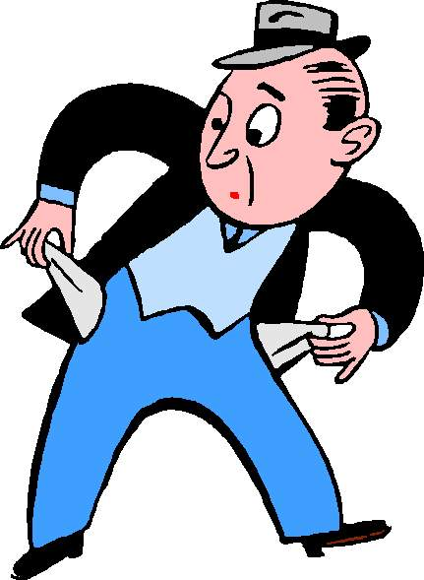
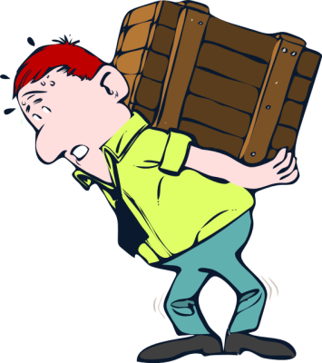
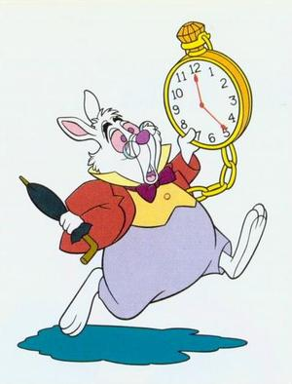
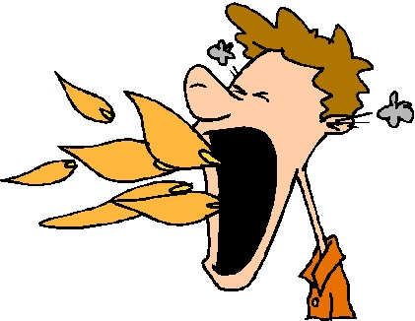
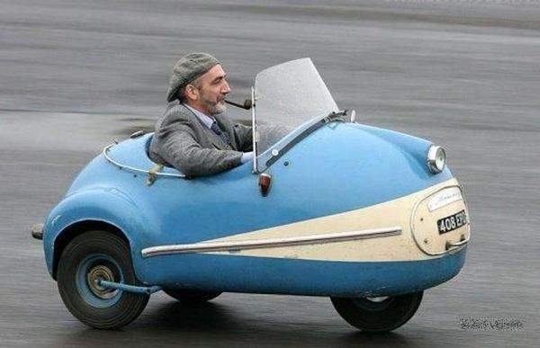
Write sentences using too and enough for each picture
___________________
___________________
___________________
___________________
___________________
___________________
___________________
___________________
___________________
___________________
___________________
___________________
___________________
___________________
___________________
___________________
___________________
___________________

