Slide 1
UNDESRTANDING MENAING FROM THE CONTEXT
1.- When Kay says, ¨ I´m almost out of cash¨, she means._________
I dont have much money b. I have a lot of money
2. When Amy says, ¨It can´t hurt to ask¨, she means____________
It´s a good ideas to ask b. It´s not a good idea to ask.
3. When Kay says, ¨It´s gorgeous¨, she means_____________
It´s very pretty b. I dont´really like it.
4. When Amy says, ¨Maybe you could get a better price¨, She means, ________
a. This is a good price b. Bargain with the salesperson

Slide 2
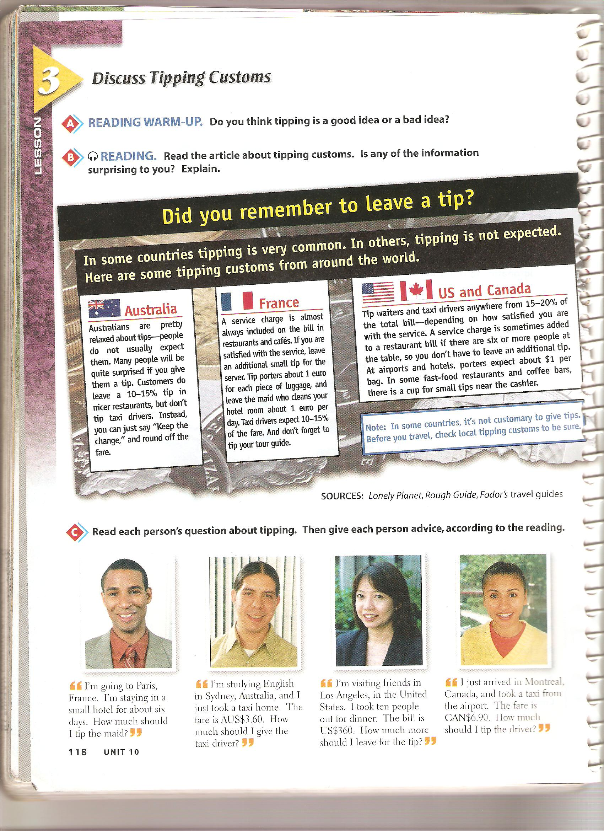

Slide 3
Read each person´s question about tipping. Then give to each person an advice

Slide 4
Complete the following sentences use the word bank
Bargain tip ATMs traveler´s checks exchange rates
1. If you´re out of cash, you can get money from___________________________
2. If there´s a service charge on the restauran bill, you don´t have to leave a _______________
3. In many countries, it´s OK to ____________ for a lower price
4. You can get the best _____________________ at banks
5. ______________ are safe and easy way to carry money when traveling
Write each sentence in another way. Use too or enough. Follow the example
1. That vase is too heavy. That vase isn´t light enough
2. Those cameras aren´t cheap enough __________________________
3. This PDA is too big_________________________________________
4. These drinks aren´t cold enough_______________________________
5. That restaurant is too noisy.__________________________________

