Slide 1
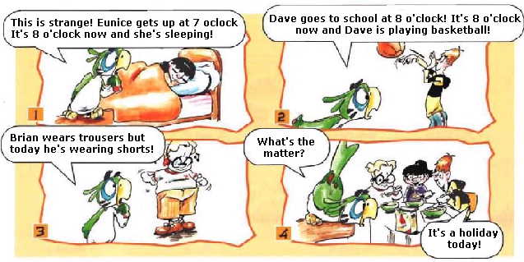
SIMPLE PRESENT / PRESENT CONTINUOUS
“””Invent a crative commic””
INCLUDE 10 SIMPLE PRESENT AND PRESENT CONTINUOUS SENTENCES MIN

