Slide 1
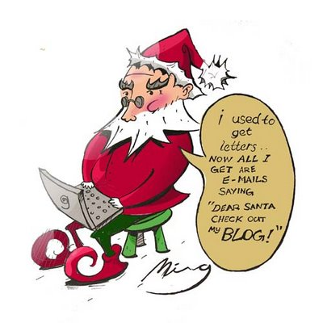
USED TO…
It refers to past habits and states. If we say that somebody used to do something, we mean that some time ago he was in the habit of doing this, but he no longer does it now.
Here are some examples:
'I used to smoke 30 cigarettes a day, but I gave up when I became convinced that smoking causes cancer.'
'I didn't use to like cricket, but now I'm getting interested in it.'
'Didn't he use to be vegetarian?' 'Yes, he did, but he started eating meat last winter and now he's a real carnivore.'

Slide 2
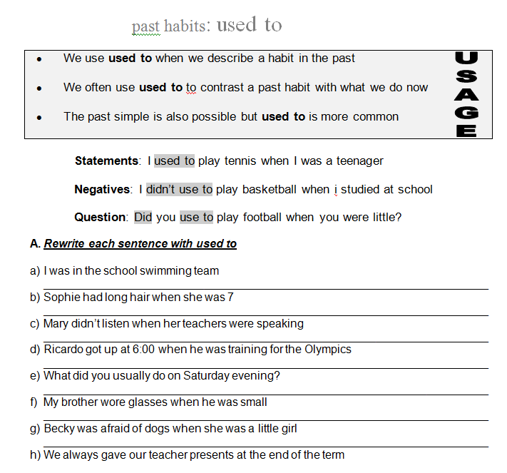

Slide 3
I used to be on a swimming team in the school.
Sofia used to have long hair when se was 7.
Mary didn’t use to listen the teachers speaking.
Ricardo used to get up at 6:00 when he was training for the Olympics
What did you used to do on Saturday evening?
My brother used to wear glasses when he was small
Becky used to be afraid of dogs when she was little
We used to give to our techers presents at the end of the term.

Slide 4
Arrange the following sentences using USED TO (+ and – )
1) I / live in a flat when I was a child.
. I used to live in a flat when I was a child
2) We / go to the beach every summer?
.Yes, we used to go to the beach every summer but not this one.
3) She / love eating chocolate, but now she hates it
. She used to love eating chocolate, but now she hates it
4) He / not / smoke
. He used to smoke
5) I / play tennis when I was at school
. I used to play tennis when I was at school
6) She / be able to speak French, but she has forgotten it all
. She used to be able to speack French, but she has forgotten it all
7) He / play golf every weekend?
. No, he used to play golf every monday
8) They both / have short hair
.They used to have long hair

Slide 5
Complete the following chart with USED TO… (+/-) Sentences
 | Now | When I was 10
Live Where… | I live in Saltillo Coahuila. | When I was 10, I used to live in Detroit, Michigan.
Free time What… | I go out with my boyfriend | When I was 10, I used to go out with my friends to play
Appearance What… | I love to wear highheels | When I was 10, I used to wear sneakers
Food What kind of… | I love eating blueberrys | When I was 10, I used to eat chocolate cereal
Dislikes What… | I hate be late at school | “ “ 10, I used to hate school
Friends Who… | I have many friends at School | “ “ 10, I used to have more friends on my neighborhood
Books What kind of… | I have religion books or novels | I used to have coloring books

Slide 6
