Slide 1
USED TO…
It refers to past habits and states. If we say that somebody used to do something, we mean that some time ago he was in the habit of doing this, but he no longer does it now.
Here are some examples:
'I used to smoke 30 cigarettes a day, but I gave up when I became convinced that smoking causes cancer.'
'I didn't use to like cricket, but now I'm getting interested in it.'
'Didn't he use to be vegetarian?' 'Yes, he did, but he started eating meat last winter and now he's a real carnivore.'

Slide 2
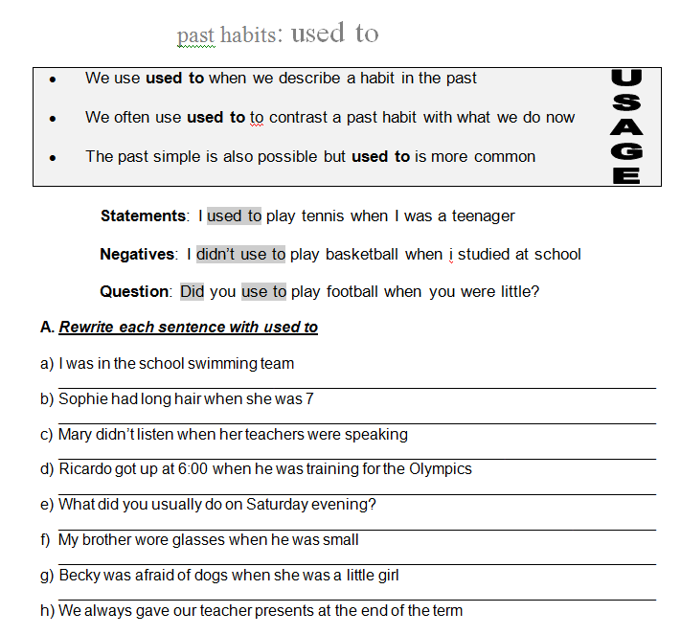
I use to be in the school swimming team
Sophie used to had long hair when she was 7.
Mary didn’t use to listen when her teachers were speaking
Ricardo used to got up at 6:00 when he was training for the Olympics
Did you use to usually do on Saturday evening?
My brother used to wore glasses when he was small
Becky used to afraid of dogs when she was a Little girl.
We always used to gave our teacher presents at the end of the term

Slide 3
Arrange the following sentences using USED TO (+ and – )
I / live in a flat when I was a child.
. I used to live in a flat when I was a child
2) We / go to the beach every summer?
. Did we use to go to the beach every summer?
3) She / love eating chocolate, but now she hates it
. She used to love eating chocolate, but now she hates it
4) He / not / smoke
. He didn’t use to smoke
5) I / play tennis when I was at school
. I used to play tennis when I was at school
6) She / be able to speak French, but she has forgotten it all
. She used to be able to speak French, but she has forgotten it all
7) He / play golf every weekend?
. Did he use to play golf every weekend?
8) They both / have short hair
. They both used to have short hair

Slide 4
Complete the following chart with USED TO… (+/-) Sentences
 | Now | When I was 10
Live Where… | I live in Parras, Coahuila | I used to live in Parral, Chihuahua
Free time What… | I listen to music | I used to watch a T.V.
Appearance What… | I have a long hair | I used to have a short hair
Food What kind of… | I like Chinese food | I used to like the fast food
Dislikes What… | I didn’t like a snakes | I didn’t use to like a beer
Friends Who… | My friends are Claudia, Alma and Paola | My friends used to are Gabriela and Nancy
Books What kind of… | I like romantic books | I used to like the tales

