Slide 1
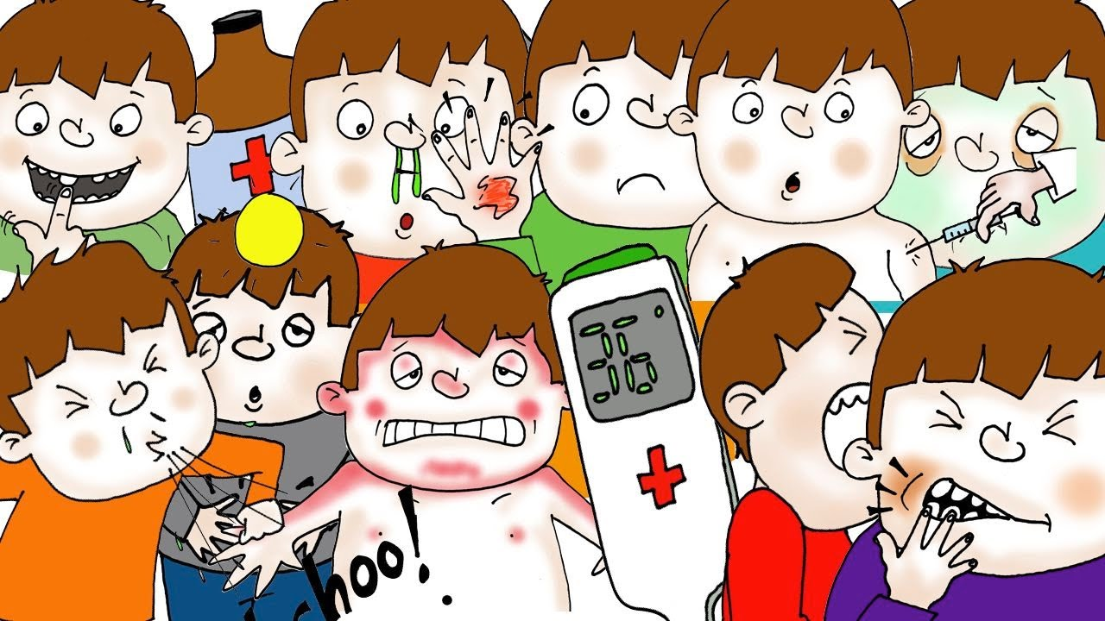
How many can you name??

Slide 2
flu
loose tooth
sneeze
temperature
toothache
injections
medicine
headache
body aches
Nazzal runoff

