Slide 1
Practice preopositions of place in the following website, print final score and attach it back
http://www.eslgamesplus.com/prepositions-of-place-esl-fun-game-online-grammar-practice/
http://learnenglishkids.britishcouncil.org/en/grammar-games/prepositions-place
Practice definite and indefinite articles in the following websites, print final score and attach it back
http://www.eslgamesplus.com/a-an-the-spin/
http://www.eslgamesworld.com/members/games/grammar/New_Snakes_%20Ladders/Articles.html
http://www.eslgamesworld.com/members/games/grammar/basketball/Articles/Articles%20definite%20and%20indefinite.html

Slide 2
Practice with object pronouns in the following website, print final score and attach it back then answer the excercise given
http://www.turtlediary.com/grade-3-games/ela-games/subject-object-pronouns-exciting-panda-game.html
Answer the following excercise use object pronouns
I can't see Mary. I can't see ________
him
she
her
Karen is next to Peter. Karen is next to ________
he
him
he
Can you help Peter and Ann? Can you help ________?
they
you
them
The cat is under the chair. Can you see __________?
he
she
it
Drink your apple juice! Drink ________!
it
its
your
We are going to the cinema. Come with ________!
we
them
us
These are my bananas. You can't eat ________
they
them
it
Carol is at school. She can't come with ________
we
us
they

Slide 3
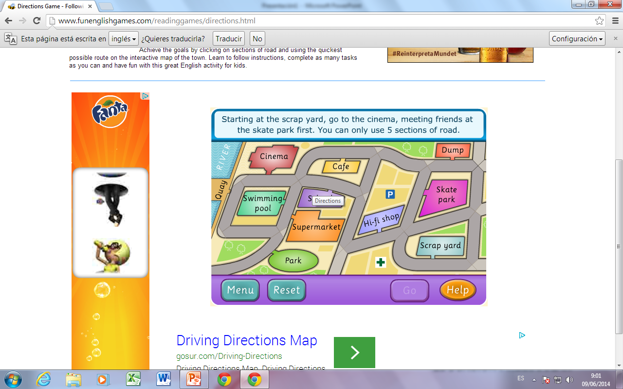
Practice following directions in the following website, print final score and attach it back then answer the excercise given
http://www.bbc.co.uk/skillswise/game/en33inst-game-destination-impossible
Practice with directions in the map. Write 5 sentences giving directions. Leaving point, scrap yard.
To the cinema:
________________________________________________________________________________________
To the swimming pool
________________________________________________________________________________________
To the dump
________________________________________________________________________________________
To the park
________________________________________________________________________________________
To the supermarket
________________________________________________________________________________________
Elm street
Lime street
2nd Avenue
3rd Avenue
5th Avenue
4th Avenue
Pine street

