Slide 5
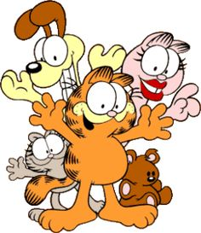
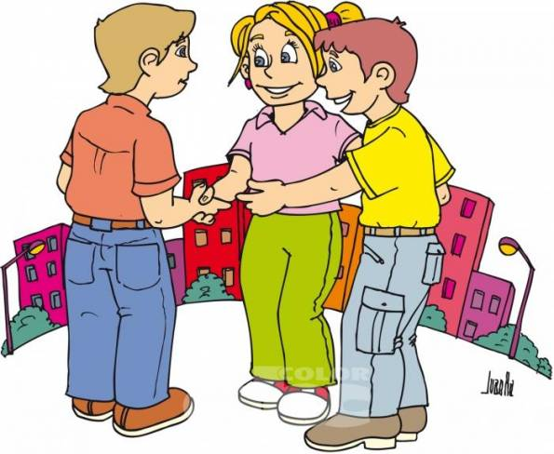
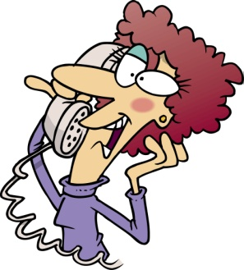
Demonstratives are also used…….
to introduce people:
This is Janet These are my friends
.
!!!!!WARNING!!!!!: We don’t say These are John and Michael. We say This is John and this is Michael
to introduce ourselves to begin a conversation on the phone:
Hello, this is David, Can I speak to Sally?

Slide 6
PRACTICE DEMOSNTRATIVES ON THE FOLLOWING WEBSITES.
CLICK ON THE LINK AND PRINT FINAL SCORE FOR EACH
http://www.freddiesville.com/games/this-that-these-those-demonstrative-pronouns-sentence-monkey-game/
http://www.grammar.cl/Games/This_That_These_Those.htm
http://learnenglishkids.britishcouncil.org/es/grammar-games/these-those

Slide 7
A BIT OF THIS AND A BIT OF THAT / A FEW OF THESE AND A FEW OF THOSE
This is a circular/chain-rotating game designed to circulate vocabulary quickly and combine it with correct use of this vs. that and these vs. those.
Choose either the blue set (for this/that) or red set (for these/those)
each person in the circle looks at the card in front of them, points at it and states "this is a..." (blue set) or "these are..." (red set).
The next student cannot take their turn until the preceding student has correctly indicated and stated what the cards in front of them and next to them are.

