Slide 1
Escuela Normal de Educación Preescolar.
Ingles.
María Elena Meza Aguado.
1 “B”.
Team 2: Whose...? And Possessive adjectives vs. Possessive Pronouns título
Alemán Chávez Mireya, E.
Alvarado Ramírez Karen, S.
Hernández Ramírez Perla, C.
López Corpus Karina, G.
Ramírez Valenzuela Alejandra, A.
Vásquez Rodríguez Karla, A.

Slide 2
Possesive adjectives
possessive adjectives indicate who has (possessor), not what you possess and come from a noun.
My
Your
His
Her
Its
Our
your
Their
Example
This is my book
Thosee are your glasses
These are his shoes
This is her pencil

Slide 4
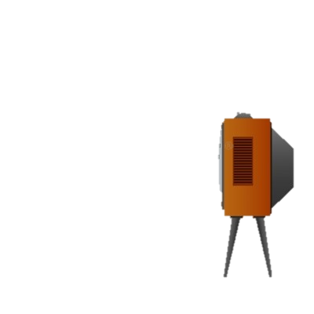
Possesive pronouns
Example
That TV is mine
This cellphone is your
This house is ours
That car is their
indicate possession and are invariable
Mine
Yours
His
Hers
Ours
Yours
Theirs
The definite article is usually omitted when the possessive pronoun comes after the verb ser:
El carro grande es mío. The big car is mine.
El carro pequeño es suyo. The small car is hers.

Slide 6
IT'S IS NOT A POSSESSIVE ADJECTIVE AND PRONOUNS There is no apostrophe in the possessive adjective its. Its has nothing to do with it's, which is a contraction of it is or it has

Slide 7
ExemplePossesive pronouns and adjectives.
Mi libro es grande. My book is large.
El tuyo es pequeño. Yours is small.
Tu carro es verde. Your car is green.
El mío es rojo. Mine is red
adjective describes a noun
pronoun takes the place of a noun

