Slide 1
Personal pronouns and the verb "to be" contract in the ways shown below:
The verb form to be negation and interrogation without the auxiliary verb to do
Conjugación | Significado
I'm | yo soy
You're | tú eres
He's She's It's | él es ella es ello es
We're | nosotros somos
You're | vosotros sois
They're | ellos/ellas son

Slide 2
Present Simple
To conjugate the present simple to use the infinitive subjects "I", "you", "we" and "they" and another for "he", "she" and "it", we added a "-s" to end of the verb
Sujeto | Conjugación
I, You, We, They | talk, eat, learn, watch, do, go...
He, She, It | talks, eats, learns, watches, does, goes...
I work with my father in the newspaper Yo trabajo con mi padre en el periódico You sing very well Tu cantas muy bien She walks a lot in the city Ella camina mucho en la ciudad We drink water every day Nosotros bebemos agua cada día The party is tonight. La fiesta es esta noche. Open the window please. Abre la ventana por favor

Slide 3
Negation in the simple present
[SUJETO] + do(es) + not + [VERBO]
In English the "do + not" shrinks "do not" and "does + not" shrink to "does not".
He does not [doesn't] eat vegetables. (Él no come verduras.)

Slide 4
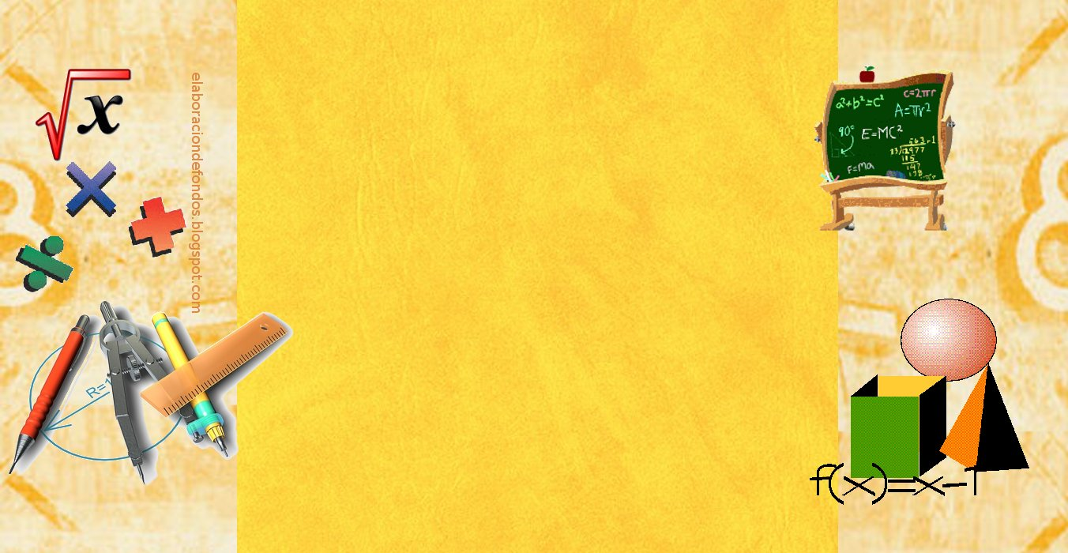
The question in the present simple
Verbo auxiliar ("to do") + sujeto + verbo principal
In interrogative sentences in the use of the auxiliary verb to do.
Prepending the subject.
The structure of closed questions or yes/no (those without interrogative particle) is:
Does Sheila help you with the housework, Dora?
¿Tiene que ayudar a Sheila con las tareas domésticas, Dora?

Slide 5
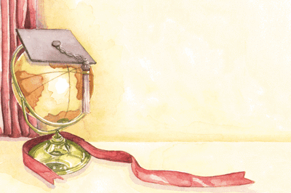
The structure of open questions (have interrogative) is:

Slide 6
Usually use the present simple with adverbs of time:
always (siempre)
every day (cada día)
usually (normalmente)
often (a menudo)
sometimes (a veces)
rarely (raramente)
hardly ever (casi nunca)
never (nunca)
Ejemplo: I am always happy. (Siempre estoy contento.)

Slide 7
It is used to speak in generalities
I does not [does not] eat vegetables.
Él no come verduras
It is used for events scheduled in the near future
The train leaves at 10:00.
El tren sale a las 10h
Used for instructions
-Do not cry.
No llores
-Do your homework.
Haz los deberes.

