Slide 1
WAS & WERE
Let's remember the structure of Was & Were:
AFFIRMATIVE | NEGATIVE | INTERROGATIVE
I was | I wasn´t | Was I ?
You were | You weren´t | Were you?
He/ she/ it was | He/She/it wasn´t | Was he/she/it ?
We/ you/ they were | We/ you/ they weren´t | Were we/ you/ they ?
Examples:
I was a fat girl when I was 5years old
She was in the swimming pool last Saturday
Were you at school yesterday at 10:00 am? Yes I was/ No I wasn´t

Slide 2
Write was or were into the gaps.
1) I_________ in England last spring.
2) We ______at school last Saturday.
3) Tina________ at home yesterday.
4) He_______ happy.
5) Robert and Stan Garry's ________friends.
6) You________ very busy on Friday.
7) They________ in front of the supermarket.
8) I _________in the museum.
9) She ________in South Africa last month.
10) Jessica and Kimberly _________late for school.
11)She is thirty now, so last year she ___ twenty-nine.
12)I got married when I ___ twenty-seven.
13)It was a great day, but we ___ so tired.
14)I didn't buy those jeans because they ___ too expensive.
15)Where ___ you yesterday afternoon?
was
were
was
was
were
were
were
was
was
were
was
was
were
were
were

Slide 3
Was was wasn't were weren't
1. I________ in London last week. (+)
2. My sister _______a very small baby. (+)
3. Where________ you this morning? (?)
4. My friends______ in the restaurant. (-)
5. The weather_________ very good. (-)
6. ________the restaurant good last night? (?)
7. My parents ____18 when they got married. (+)
8. ______Robert at school yesterday? (?)
9. All the trains______ late today. (+)
10. Those pizzas ________very good. (-)
was
was
were
weren’t
wasn’t
Was
were
Was
were
weren’t

Slide 4
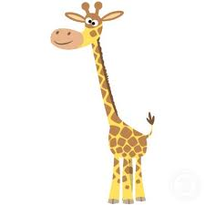
There was | There were
There was a giraffe at the zoo | There were many kids in the park
Complete with there was or there were.
_______ a bank near my house.
_______ten children in the park.
_______ two kittens in the basket.
________ a small shop between the bank and the supermarket.
________ many bottles of milk in the fridge.
________ some pencils on the desk.
________only one book on the table.
________ an old man in the street.
________a lot of noise in the classroom.
________a huge crocodile in the river.
There was
There were
There were
There was
There were
There were
There was
There was
There were
There was

Slide 5
Memory Game
You have two minutes to look the following pictures
Use was and were to mention how many you can remember.

Slide 6





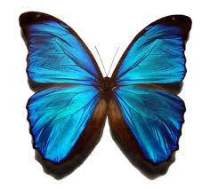

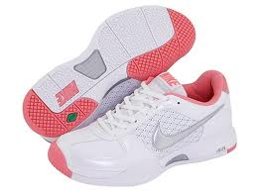



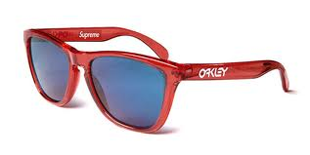

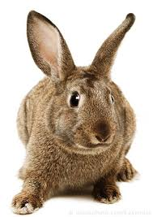
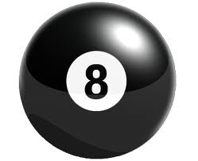
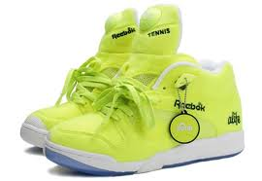

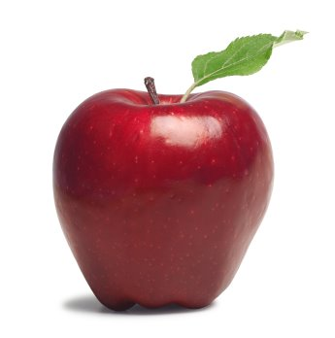
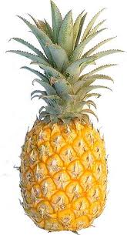
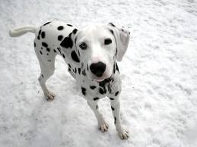

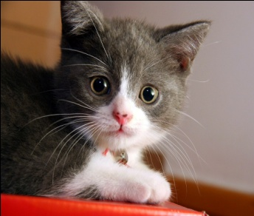


Slide 7
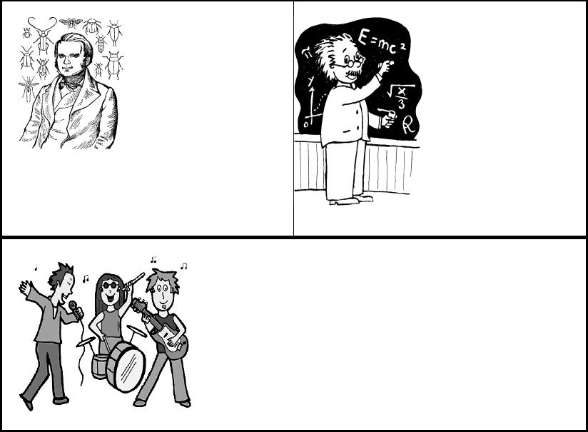
V. Choose the correct verb.
Charles Darwin.
Charles Darwin [was] born on February 12, 1809. He [was] a British naturalist who became famous for histories of evolution and natural selection. In South America, Darwin found that fossils of extinct animals [were] similar to modern species. Many people [were] strongly opposed to the idea of evolution because it conflicted with their religious beliefs. Throughout his life, Darwin [was] a reserved, thorough, hardworking scholar.
Albert Einstein.
When Albert Einstein [was] young, his parents worried about him. Einstein's parents [were]concerned that Albert was "slow." Albert [was] a terrible student who didn't want to attend classes regularly and take exams. Einstein's best-known work, the theory of relativity, [was] published in 1905.Unfortunately, the theory of relativity [was] used to create the atomic bomb.

Slide 8
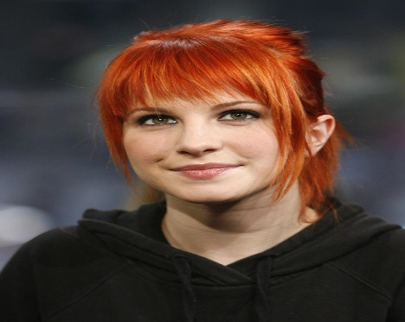
Hayley Nichole Williams
Hayley Nichole Williams was born on December 27, 1988 in Mississippi, USA. She is a American singer and she became famous for his song “that's what you get” in 2007. At the age of 15, she created the band Paramore, and has toured with them ever since. At 16 years old, released her first album with Paramore, a rock-pop band that featured her vocals and her lyrics. After a while, Paramore signed with a record company, making them one of the only female fronted bands on the label’s roster, and began courting an international audience after of 2005. From the start, Williams attracted a good deal of attention with her fiery red hair. Williams remained focused on Paramore, though, whose 2007 sophomore effort Riot! went platinum in the U.S. and achieved gold status in four other countries.
Paramore also charted another hit with their contribution to the Twilight soundtrack, “Decode.” Meanwhile, Paramore wrapped up work on a third album, Brand New Eyes, and released it that September, where it debuted at number two and quickly went gold.

