Slide 1
WAS & WERE
Let's remember the structure of Was & Were:
AFFIRMATIVE | NEGATIVE | INTERROGATIVE
I was | I wasn´t | Was I ?
You were | You weren´t | Were you?
He/ she/ it was | He/She/it wasn´t | Was he/she/it ?
We/ you/ they were | We/ you/ they weren´t | Were we/ you/ they ?
Examples:
I was a fat girl when I was 5years old
She was in the swimming pool last Saturday
Were you at school yesterday at 10:00 am? Yes I was/ No I wasn´t

Slide 2
Write was or were into the gaps.
1) I___was_ in England last spring.
2) We were at school last Saturday.
3) Tina was at home yesterday.
4) He was happy.
5) Robert and Stan Garry's were friends.
6) You were very busy on Friday.
7) They were in front of the supermarket.
8) I was in the museum.
9) She was in South Africa last month.
10) Jessica and Kimberly were late for school.
11)She is thirty now, so last year she was twenty-nine.
12)I got married when I was twenty-seven.
13)It was a great day, but we were so tired.
14)I didn't buy those jeans because they were too expensive.
15)Where were you yesterday afternoon?

Slide 3
Was was wasn't were weren't
1. I was in London last week. (+)
2. My sister were a very small baby. (+)
3. Where was you this morning? (?)
4. My friends weren´t in the restaurant. (-)
5. The weather weren´t very good. (-)
6. Were the restaurant good last night? (?)
7. My parents were 18 when they got married. (+)
8. was Robert at school yesterday? (?)
9. All the trains were late today. (+)
10. Those pizzas wasn´t very good. (-)

Slide 4
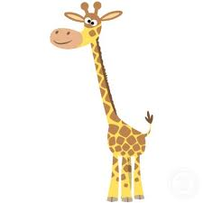
There was | There were
There was a giraffe at the zoo | There were many kids in the park
Complete with there was or there were.
There was a bank near my house.
There were ten children in the park.
There were two kittens in the basket.
There was a small shop between the bank and the supermarket.
There were many bottles of milk in the fridge.
There was some pencils on the desk.
There was only one book on the table.
There was an old man in the street.
There was a lot of noise in the classroom.
There was a huge crocodile in the river.

Slide 5
Memory Game
You have two minutes to look the following pictures
Use was and were to mention how many you can remember.

Slide 6











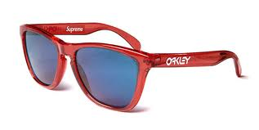



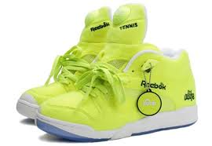



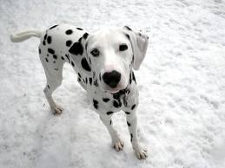
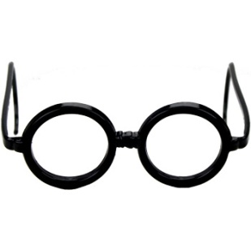
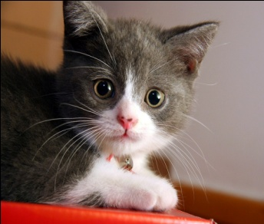


Slide 7
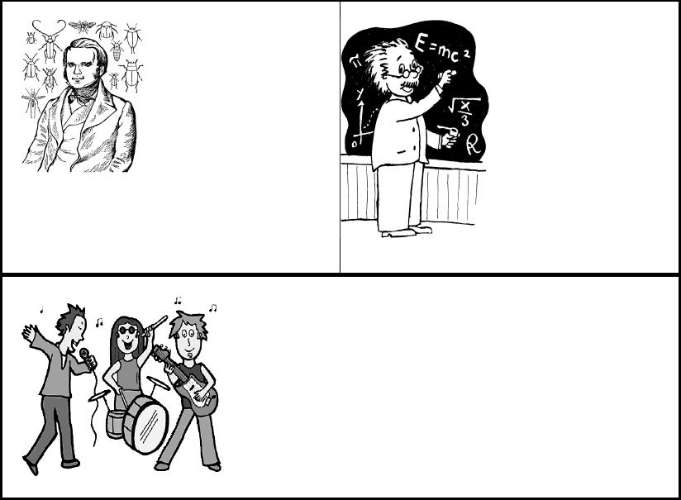
V. Choose the correct verb.
Charles Darwin [was ] born on February 12, 1809. He [was ] a British naturalist who became famous for histories of evolution and natural selection. In South America, Darwin found that fossils of extinct animals [ were] similar to modern species. Many people [ were] strongly opposed to the idea of evolution because it conflicted with their religious beliefs. Throughout his life, Darwin [was ] a reserved, thorough, hardworking scholar. When Albert Einstein [was ] young, his parents worried about him. Einstein's parents [ were]concerned that Albert was "slow." Albert [was] a terrible student who didn't want to attend classes regularly and take exams. Einstein's best-known work, the theory of relativity, [was ] published in 1905.Unfortunately, the theory of relativity [were] used to create the atomic bomb.

Slide 8
Draw and write a famous person´s biography
Heathcliff Andrew Ledger (4 April 1979 – 22 January 2008) was an Australian actor and director. After performing roles in Australian television and film during the 1990s, Ledger left for the United States in 1998 to develop his film career. His work comprised nineteen films, including 10 Things I Hate About You (1999), The Patriot (2000), A Knight's Tale (2001), Monster's Ball (2001), Ned Kelly (2003), The Brothers Grimm (2005), Lords of Dogtown (2005), Brokeback Mountain (2005), Casanova (2005), Candy (2006), I'm Not There (2007), The Dark Knight (2008) and The Imaginarium of Doctor Parnassus (2009). He also produced and directed music videos and aspired to be a film director.
For his portrayal of Ennis Del Mar in Brokeback Mountain, Ledger won the New York Film Critics Circle Award for Best Actor and Best International Actor from the Australian Film Institute, and was nominated for the BAFTA Award for Best Actor in a Leading Role and for the Academy Award for Best Actor. Posthumously he shared the 2007 Independent Spirit Robert Altman Award with the rest of the ensemble cast, the director, and the casting director for the film I'm Not There, which was inspired by the life and songs of American singer-songwriter Bob Dylan. In the film, Ledger portrayed a fictional actor named Robbie Clark, one of six characters embodying aspects of Dylan's life and persona.
Ledger died on 22 January 2008 from an accidental intoxication from prescription drugs. A few months before his death, Ledger had finished filming his performance as the Joker in The Dark Knight.

Slide 9
