Slide 1
WAS & WERE
Let's remember the structure of Was & Were:
AFFIRMATIVE | NEGATIVE | INTERROGATIVE
I was | I wasn´t | Was I ?
You were | You weren´t | Were you?
He/ she/ it was | He/She/it wasn´t | Was he/she/it ?
We/ you/ they were | We/ you/ they weren´t | Were we/ you/ they ?
Examples:
I was a fat girl when I was 5years old
She was in the swimming pool last Saturday
Were you at school yesterday at 10:00 am? Yes I was/ No I wasn´t

Slide 2
Write was or were into the gaps.
1) I_____was____ in England last spring.
2) We _were_____at school last Saturday.
3) Tina__was______ at home yesterday.
4) He___was____ happy.
5) Robert and Stan Garry's ___were_____friends.
6) You____were____ very busy on Friday.
7) They__were______ in front of the supermarket.
8) I ____was_____in the museum.
9) She ___were_____in South Africa last month.
10) Jessica and Kimberly ___were______late for school.
11)She is thirty now, so last year she __was_ twenty-nine.
12)I got married when I _was__ twenty-seven.
13)It was a great day, but we _were__ so tired.
14)I didn't buy those jeans because they _were__ too expensive.
15)Where _were__ you yesterday afternoon?

Slide 3
Was was wasn't were weren't
1. I__was____ in London last week. (+)
2. My sister __was_____a very small baby. (+)
3. Where_____were___ you this morning? (?)
4. My friends___was___ in the restaurant. (-)
5. The weather___was______ very good. (-)
6.was____the restaurant good last night? (?)
7. My parents _were__18 when they got married. (+)
8. _were _____Robert at school yesterday? (?)
9. All the trains__was____ late today. (+)
10. Those pizzas _was_______very good. (-)

Slide 4
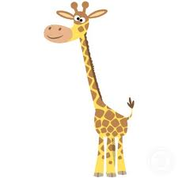
There was | There were
There was a giraffe at the zoo | There were many kids in the park
Complete with there was or there were.
there was a bank near my house.
There were ten children in the park.
There were two kittens in the basket.
There was a small shop between the bank and the supermarket.
There was many bottles of milk in the fridge.
there were some pencils on the desk.
There was only one book on the table.
There was an old man in the street.
There were a lot of noise in the classroom.
There was a huge crocodile in the river.

Slide 5
Memory Game
You have two minutes to look the following pictures
Use was and were to mention how many you can remember.

Slide 6

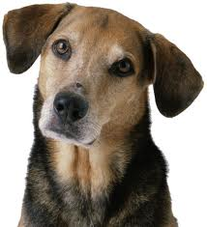



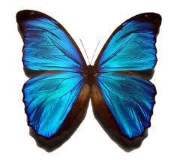

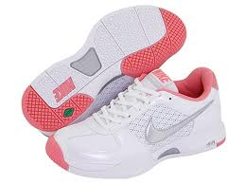



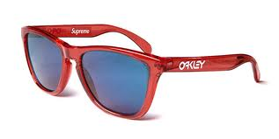

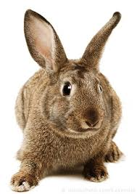
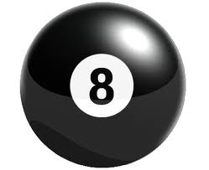
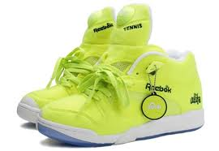


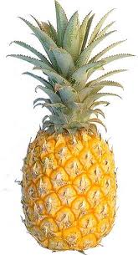
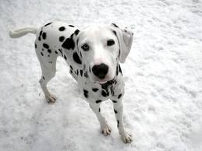

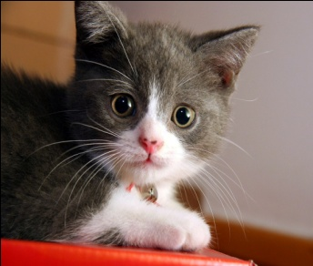
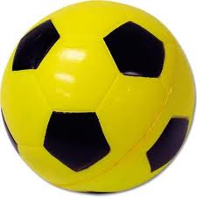

Slide 7
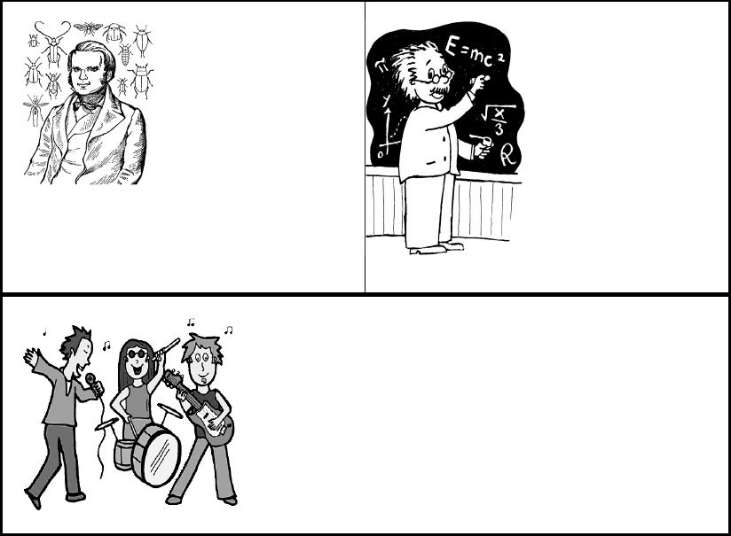
V. Choose the correct verb.
Charles Darwin [were] born on February 12, 1809. He [were] a British naturalist who became famous for histories of evolution and natural selection. In South America, Darwin found that fossils of extinct animals [were] similar to modern species. Many people [were] strongly opposed to the idea of evolution because it conflicted with their religious beliefs. Throughout his life, Darwin [were] a reserved, thorough, hardworking scholar. When Albert Einstein [was were] young, his parents worried about him. Einstein's parents [was were]concerned that Albert was "slow." Albert [were] a terrible student who didn't want to attend classes regularly and take exams. Einstein's best-known work, the theory of relativity, [was] published in 1905.Unfortunately, the theory of relativity [was] used to create the atomic bomb.

Slide 8
Leonardo di ser Piero da Vinci, more commonly Leonardo da Vinci (Italian: [leoˈnardo da (v)ˈvintʃi] ( listen); 15 April 1452 – 2 May 1519), was an Italian polymath whose areas of interest included invention, painting, sculpting, architecture, science, music, mathematics, engineering, literature, anatomy, geology, astronomy, botany, writing, history, and cartography. He has been variously called the father of paleontology, ichnology, and architecture, and is widely considered one of the greatest painters of all time. Sometimes credited with the inventions of the parachute, helicopter and tank,his genius epitomized the Renaissance humanist ideal.
Work in groups of 3
15 lines min.

