Slide 1
WAS & WERE
Let's remember the structure of Was & Were:
AFFIRMATIVE | NEGATIVE | INTERROGATIVE
I was | I wasn´t | Was I ?
You were | You weren´t | Were you?
He/ she/ it was | He/She/it wasn´t | Was he/she/it ?
We/ you/ they were | We/ you/ they weren´t | Were we/ you/ they ?
Examples:
I was a fat girl when I was 5years old
She was in the swimming pool last Saturday
Were you at school yesterday at 10:00 am? Yes I was/ No I wasn´t

Slide 2
Write was or were into the gaps.
1) I__was_______ in England last spring.
2) We _were_____at school last Saturday.
3) Tina__was______ at home yesterday.
4) He_was______ happy.
5) Robert and Stan Garry's __were______friends.
6) You__were______ very busy on Friday.
7) They__were______ in front of the supermarket.
8) I _was________in the museum.
9) She _was_______in South Africa last month.
10) Jessica and Kimberly ____were_____late for school.
11)She is thirty now, so last year she __was_ twenty-nine.
12)I got married when I _was__ twenty-seven.
13)It was a great day, but we _wasn´t__ so tired.
14)I didn't buy those jeans because they _was__ too expensive.
15)Where _were__ you yesterday afternoon?

Slide 3
Was was wasn't were weren't
1. I__was______ in London last week. (+)
2. My sister __was_____a very small baby. (+)
3. Where__were______ you this morning? (?)
4. My friends__weren´t____ in the restaurant. (-)
5. The weather____wasn´t_____ very good. (-)
6. _ Were_the restaurant good last night? (?)
7. My parents _were_18 when they got married. (+)
8. _Was_____Robert at school yesterday? (?)
9. All the trains__was____ late today. (+)
10. Those pizzas __weren´t______very good. (-)

Slide 4
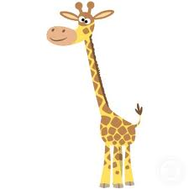
There was | There were
There was a giraffe at the zoo | There were many kids in the park
Complete with there was or there were.
There was___ a bank near my house.
There were__ten children in the park.
There were__ two kittens in the basket.
There was_____ a small shop between the bank and the supermarket.
There were____ many bottles of milk in the fridge.
There were________ some pencils on the desk.
There was________only one book on the table.
There was________ an old man in the street.
There was________a lot of noise in the classroom.
There was a huge crocodile in the river.

Slide 5
Memory Game
You have two minutes to look the following pictures
Use was and were to mention how many you can remember.

Slide 6

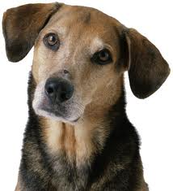



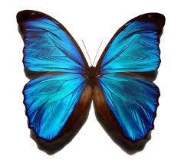

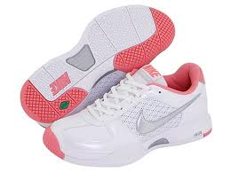
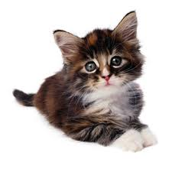


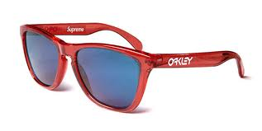

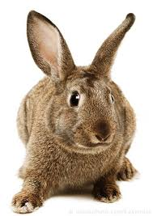
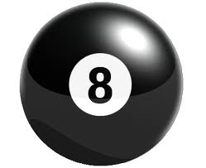
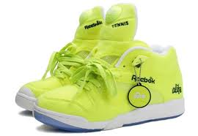


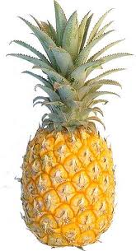
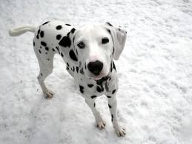

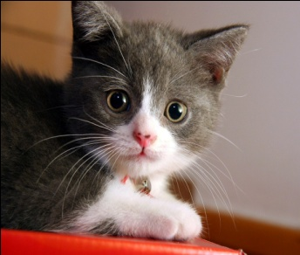
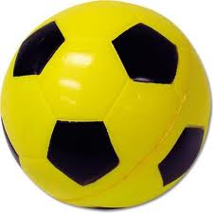

Slide 7
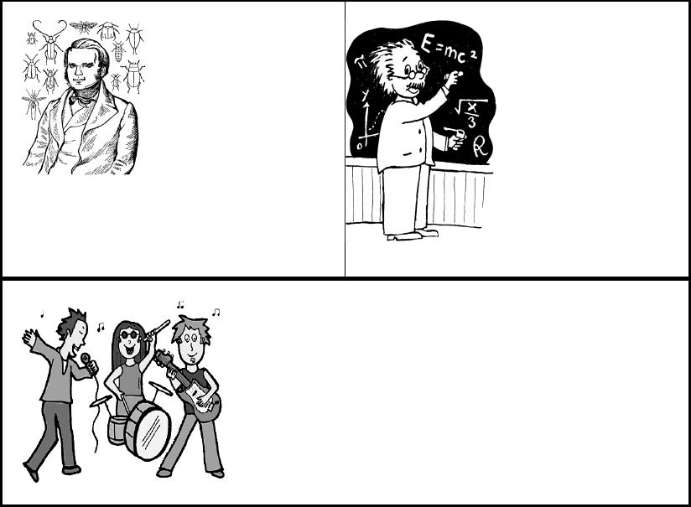
V. Choose the correct verb.
Charles Darwin [was were] born on February 12, 1809. He [was were] a British naturalist who became famous for histories of evolution and natural selection. In South America, Darwin found that fossils of extinct animals [was were] similar to modern species. Many people [was were] strongly opposed to the idea of evolution because it conflicted with their religious beliefs. Throughout his life, Darwin [was were] a reserved, thorough, hardworking scholar. When Albert Einstein [was were] young, his parents worried about him. Einstein's parents [was were]concerned that Albert was "slow." Albert [was were] a terrible student who didn't want to attend classes regularly and take exams. Einstein's best-known work, the theory of relativity, [was were] published in 1905.Unfortunately, the theory of relativity [was were] used to create the atomic bomb.

Slide 8
Draw and write a famous person´s biography
______________________________________________________________________
Leonardo da Vinci was a leading artist and intellectual of the Italian Renaissance who known for his enduring works «The last supper» and «Mona Lisa». He was born on April 15, 1452.
______________________________________________________________________
______________________________________________________________________
______________________________________________________________________
______________________________________________________________________
______________________________________________________________________
Work in groups of 3
15 lines min.

