Slide 1
WAS & WERE
Let's remember the structure of Was & Were:
AFFIRMATIVE | NEGATIVE | INTERROGATIVE
I was | I wasn´t | Was I ?
You were | You weren´t | Were you?
He/ she/ it was | He/She/it wasn´t | Was he/she/it ?
We/ you/ they were | We/ you/ they weren´t | Were we/ you/ they ?
Examples:
I was a fat girl when I was 5years old
She was in the swimming pool last Saturday
Were you at school yesterday at 10:00 am? Yes I was/ No I wasn´t

Slide 2
Write was or were into the gaps.
1) I was in England last spring.
2) We were at school last Saturday.
3) Tina was at home yesterday.
4) He was happy.
5) Robert and Stan Garry's were friends.
6) You were very busy on Friday.
7) They were in front of the supermarket.
8) I was in the museum.
9) She was in South Africa last month.
10) Jessica and Kimberly were late for school.
11)She is thirty now, so last year she was twenty-nine.
12)I got married when I was twenty-seven.
13)It was a great day, but we were so tired.
14)I didn't buy those jeans because they were too expensive.
15)Where were you yesterday afternoon?

Slide 3
Was was wasn't were weren't
1. I was in London last week. (+)
2. My sister was a very small baby. (+)
3. Where were you this morning? (?)
4. My friendsweren´t in the restaurant. (-)
5. The weather wasn´t very good. (-)
6.Was the restaurant good last night? (?)
7. My parents were18 when they got married. (+)
8. Was Robert at school yesterday? (?)
9. All the trains were late today. (+)
10. Those pizzas weren´t very good. (-)

Slide 4
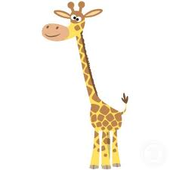
There was | There were
There was a giraffe at the zoo | There were many kids in the park
Complete with there was or there were.
There was a bank near my house.
There were ten children in the park.
There were two kittens in the basket.
There was a small shop between the bank and the supermarket.
There were many bottles of milk in the fridge.
There were some pencils on the desk.
There was only one book on the table.
There was an old man in the street.
There were a lot of noise in the classroom.
There was a huge crocodile in the river.

Slide 5
Memory Game
You have two minutes to look the following pictures
Use was and were to mention how many you can remember.

Slide 6

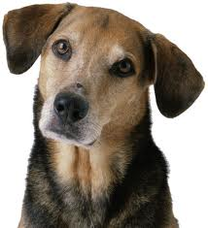



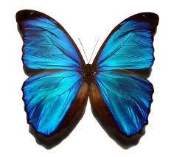

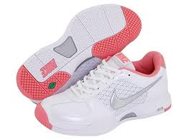
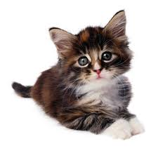
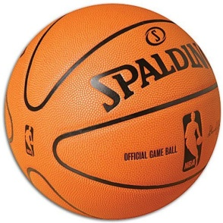

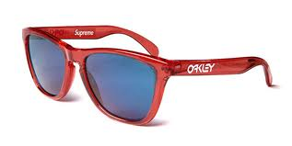

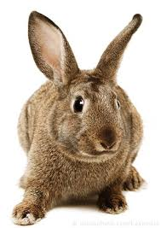
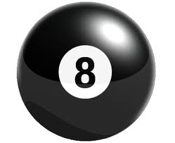
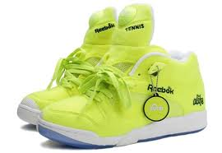

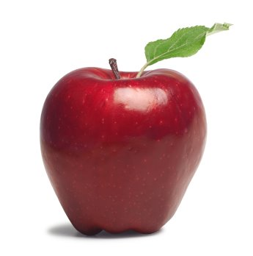
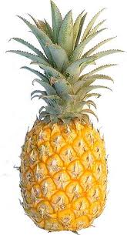
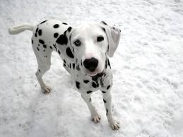

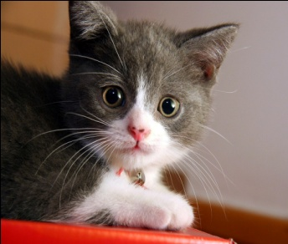
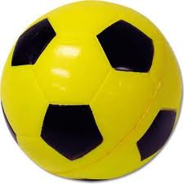

Slide 7
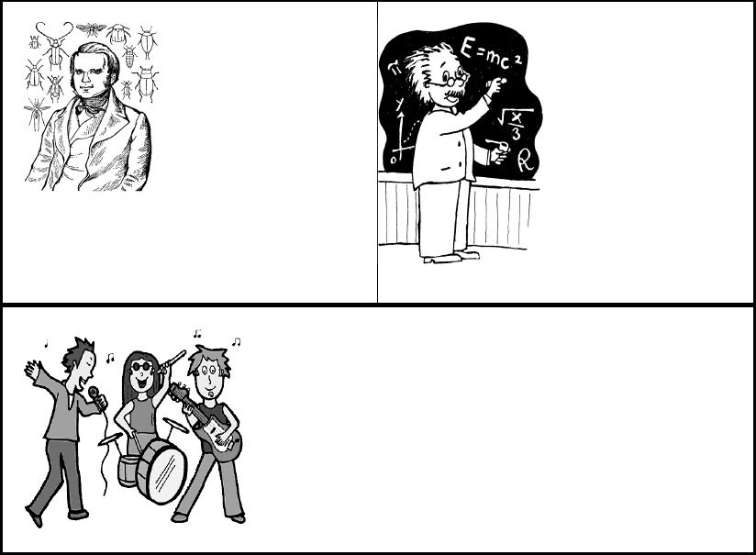
V. Choose the correct verb.
Charles Darwin [was were] born on February 12, 1809. He [was were] a British naturalist who became famous for histories of evolution and natural selection. In South America, Darwin found that fossils of extinct animals [was were] similar to modern species. Many people [was were] strongly opposed to the idea of evolution because it conflicted with their religious beliefs. Throughout his life, Darwin [was were] a reserved, thorough, hardworking scholar. When Albert Einstein [was were] young, his parents worried about him. Einstein's parents [was were] concerned that Albert was "slow." Albert [was were] a terrible student who didn't want to attend classes regularly and take exams. Einstein's best-known work, the theory of relativity, [was were] published in 1905.Unfortunately, the theory of relativity [was were] used to create the atomic bomb.

Slide 8
Draw and write a famous person´s biography
FRIDA KAHLO.- She was born on July 6, 1907 in Coyoacan. She was a Mexican painter. Although she moved in the environment of the great Mexican muralists of his time and shared his ideals, Frida Kahlo created a completely personal, naive and deeply metaphorical painting while derived from his exalted sensitivity and various events that marked his life . She was married the famous Mexican muralist Diego Rivera, his life was marked by misfortune of contracting polio and later by a serious accident in his youth that kept her bedridden for long periods, reaching up to 32 undergo surgery.
Work in groups of 3
15 lines min.

