Slide 1
WAS & WERE
Let's remember the structure of Was & Were:
AFFIRMATIVE | NEGATIVE | INTERROGATIVE
I was | I wasn´t | Was I ?
You were | You weren´t | Were you?
He/ she/ it was | He/She/it wasn´t | Was he/she/it ?
We/ you/ they were | We/ you/ they weren´t | Were we/ you/ they ?
Examples:
I was a fat girl when I was 5years old
She was in the swimming pool last Saturday
Were you at school yesterday at 10:00 am? Yes I was/ No I wasn´t

Slide 2
Write was or were into the gaps.
1) I______was___ in England last spring.
2) We _____were_at school last Saturday.
3) Tina___was_____ at home yesterday.
4) He_____was__ happy.
5) Robert and Stan Garry's ___were_____friends.
6) You____were____ very busy on Friday.
7) They___were_____ in front of the supermarket.
8) I ____was_____in the museum.
9) She _was_______in South Africa last month.
10) Jessica and Kimberly ____were_____late for school.
11)She is thirty now, so last year she _was__ twenty-nine.
12)I got married when I _was__ twenty-seven.
13)It was a great day, but we __was_ so tired.
14)I didn't buy those jeans because they _were__ too expensive.
15)Where __were_ you yesterday afternoon?

Slide 3
Was was wasn't were weren't
1. I____was____ in London last week. (+)
2. My sister _were______a very small baby. (+)
3. Where_____were___ you this morning? (?)
4. My friends____weren´t__ in the restaurant. (-)
5. The weather____wa´sn´t_____ very good. (-)
6. ___were_____the restaurant good last night? (?)
7. My parents _was___18 when they got married. (+)
8. _Was_____Robert at school yesterday? (?)
9. All the trains____were__ late today. (+)
10. Those pizzas ___weren´t_____very good. (-)

Slide 4
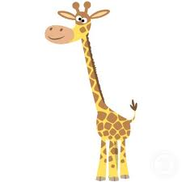
There was | There were
There was a giraffe at the zoo | There were many kids in the park
Complete with there was or there were.
___there was____ a bank near my house.
___There were____ten children in the park.
___There were_ two kittens in the basket.
__there was______ a small shop between the bank and the supermarket.
__There were ___ many bottles of milk in the fridge.
___there were_____ some pencils on the desk.
___there was_____only one book on the table.
____there was____ an old man in the street.
_____there was___a lot of noise in the classroom.
___there was_____a huge crocodile in the river.

Slide 5
Memory Game
You have two minutes to look the following pictures
Use was and were to mention how many you can remember.

Slide 6

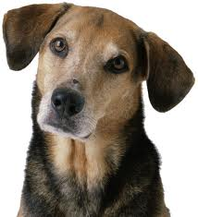



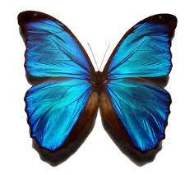
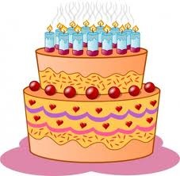
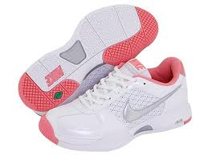
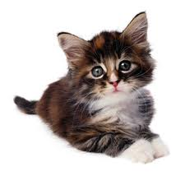


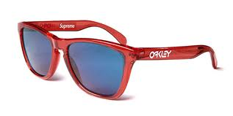

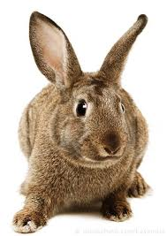
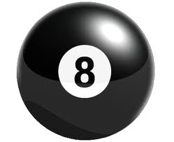
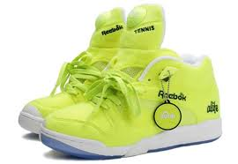

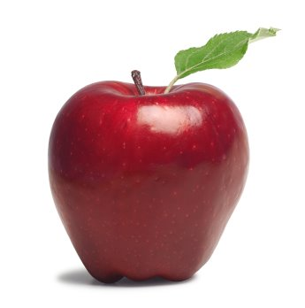
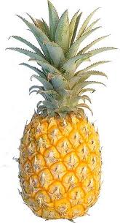
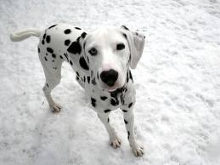

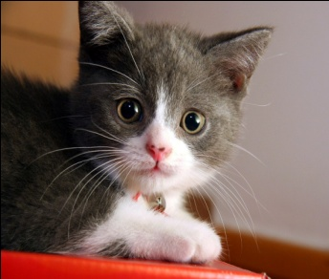
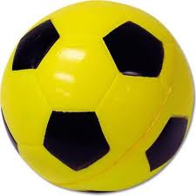

Slide 7
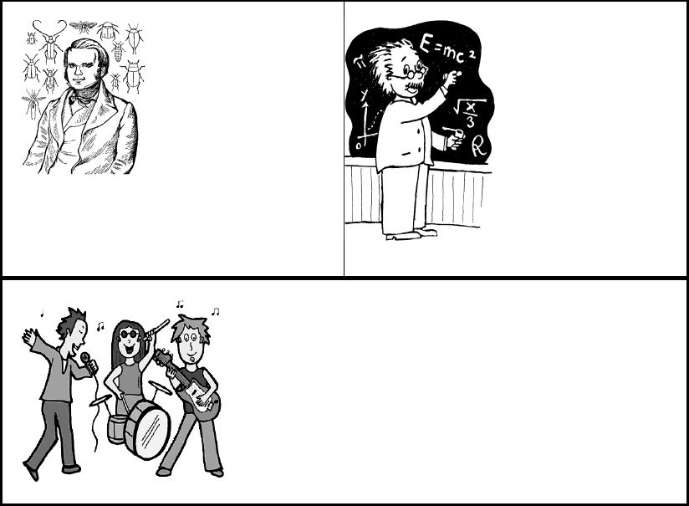
V. Choose the correct verb.
Charles Darwin [was were] born on February 12, 1809. He [was were] a British naturalist who became famous for histories of evolution and natural selection. In South America, Darwin found that fossils of extinct animals [was were] similar to modern species. Many people [was were] strongly opposed to the idea of evolution because it conflicted with their religious beliefs. Throughout his life, Darwin [was were] a reserved, thorough, hardworking scholar. When Albert Einstein [was were] young, his parents worried about him. Einstein's parents [was were]concerned that Albert was "slow." Albert [was were] a terrible student who didn't want to attend classes regularly and take exams. Einstein's best-known work, the theory of relativity, [was were] published in 1905.Unfortunately, the theory of relativity [was were] used to create the atomic bomb.

Slide 8
Draw and write a famous person´s biography
Nelson Mandela was born in 1918 in the village of Mvezo in South Africa. His father, Gadla Henry Mphakanyiswa, was an important man. He worked for the King and was the chief of the village. Nelson´s mother was called Nosekeni Fanny.
Nelson Mandela´s father Gadla was a proud an fair man. He always tried to do the thing for his people. Because of this he argued with somebody and lost his money and his important job in the village. After this the family moved to Qunu, another small village. Nelson Mandela had a very happy childhood. He went to the local school and was a good student. But when he was ten years old his father died, and his cousin King Jongintaba told Nelson to come and live whit him. Nelson had to say goodbye to his family.
Work in groups of 3
15 lines min.

