Slide 1
2
4
5
3
1
6

Slide 2
gary

Slide 3
shorter
older
funny
big
handsome

Slide 4
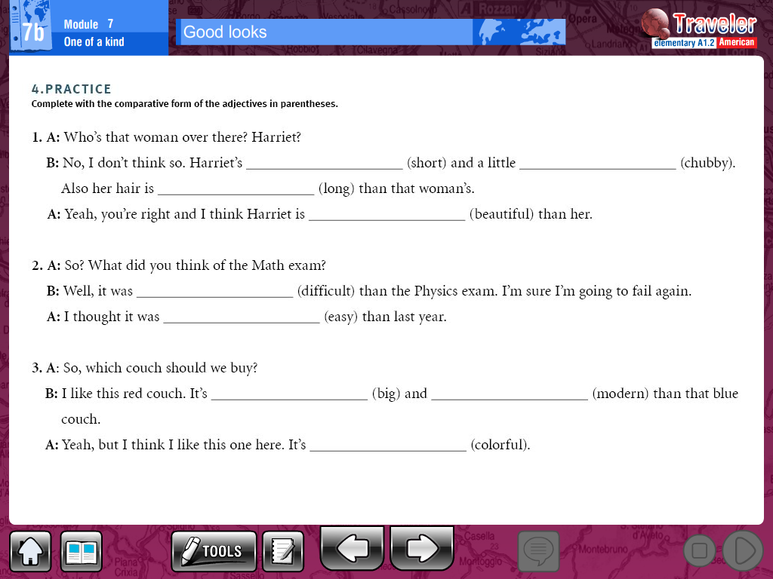
shorter
More chubby
longer
More beautiful
More difficult
easier
bigger
More modern
More colorful

Slide 5
________________________________________________________________________________________________________________________________________________________________________________________________________________________________________________________________________________________________________________________________________________

