Slide 1
MODULE 5
That’s strange

Slide 2
Passed, become engaged, took, knew, to pop, going to have, did, would be, waiting, failed to materialize, never asked, began to dawn, never would

Slide 3
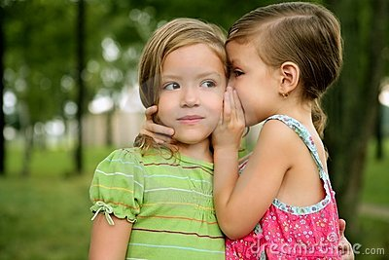
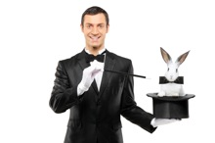
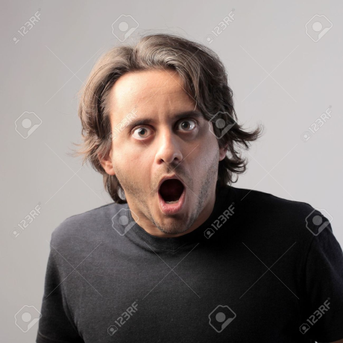
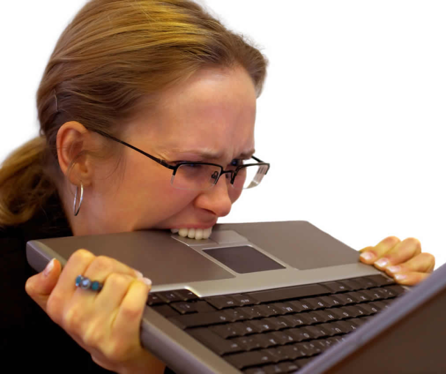
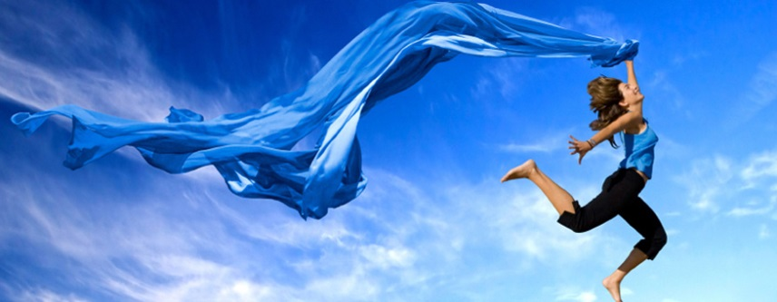
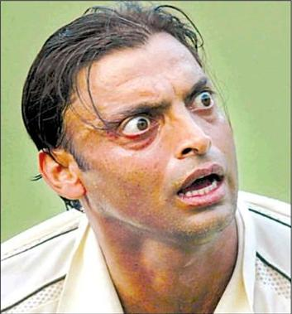
VOCABULARY

Slide 4
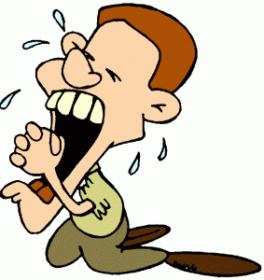
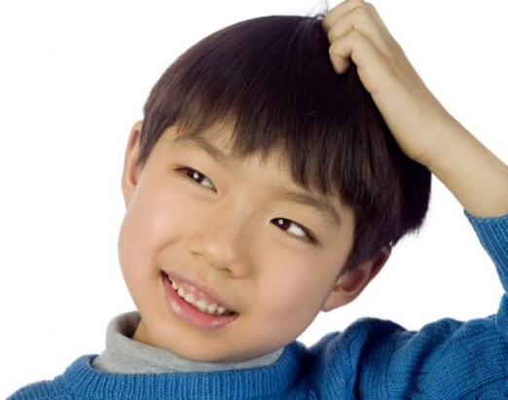
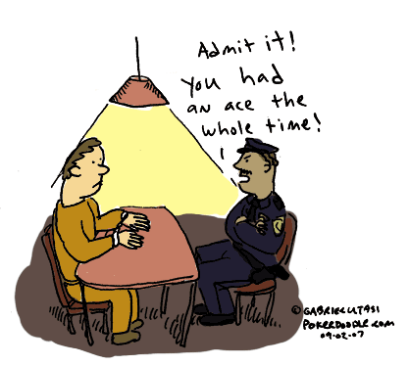
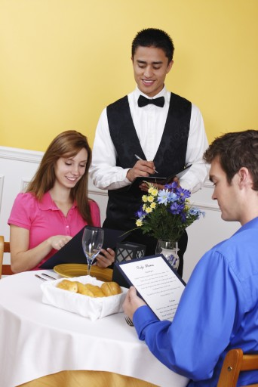
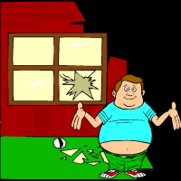
VOCABULARY

Slide 5
Grammar
Past Perfect Simple
Yesterday Yéssica was sleepy because she had worked on homework until late.
She passed the test because she had studied hard.
The ghost had vanished by the time I looked.
Past Perfect Progressive
When Andrea arrived the ghost had been watching the class for some time.

Slide 6
Practice
AFFIRMATIVE
1 When he went to the garage he found that his car_______________.
2 When TV became popular, radio__________________.
3 After the party, the guests told the hostess that they________________.
NEGATIVE
4 Before Columbus landed the people of Cuba_____________________.
5 When I went to Chiapas, El Chichonal__________________.
6 Lee Harvey Oswald told the police that he_______________________.
INTERROGATIVE
7 ______the Carboniferous Age_________ when man first appeared?
8 ______the children already_________to bed when their grandmother called?
9 ______they_________ their dinner before leaving the table?

Slide 7
Oral PRACTICE Past Perfect Formula:
By the time I got to the movie theatre my brother_________________
By the time we arrived to the airport the plane_____________
We played Monopoly after we______________
When she went to buy a present for her boyfriend the shop______________
At 7 o’clock all the spectators at the concert ________________
I found her notes after she_____________
I didn’t say anything until she _____________
By the time Doris got to the party,everyone___________
When we entered the stadium, the concert ______ already _______.

Slide 8
Oral PRACTICE Past Perfect Continuous Formula:
What had the nurse been doing before we arrived?
What had the children been saying when she told them to be quiet?
Had she telephoned the Red Cross by the time her husband came?

Slide 9
HOMEWORK
Complete workbook p. 45,46 ex. A, B and C
Study new vocabulary.
Complete reading student book p.72

