Slide 1
That’s Strange
5a

Slide 2
VOCABULARY

Slide 3
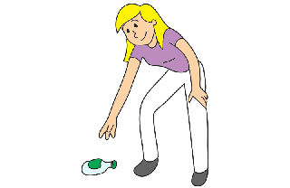
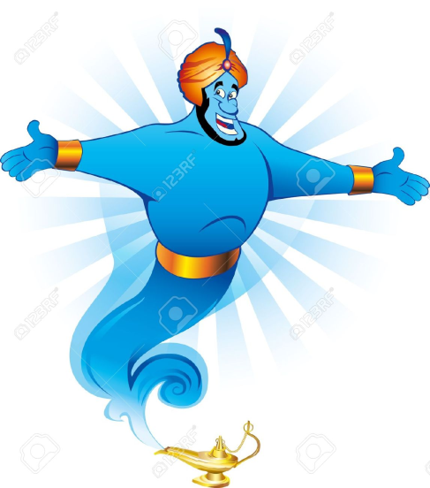
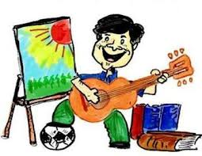
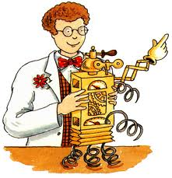
VOCABULARY

Slide 4
He said, she said…these words are important for more than gossiping. Grammar
They help English speakers understand exactly who said what. Sometimes the words are direct, or quoted. Other times they are coming through an intermediary. A tells B what C said. This kind of speech, the kind that isn’t quoted directly, is referred to as indirect speech. It’s also called reported speech.

Slide 6
Oral practice activity
Though individuals go through plenty of changes as they age, many suffer hearing loss.
Role play: one person plays a grandparent with hearing loss, another plays the grandchild who must repeat everything for the grandparent and a third person who will play a travel agent. The grandparent and the travel agent will have a conversation, but the grandparent won’t be able to hear anything the agent says. The grandchild must repeat everything for the grandparent using reported speech AND past perfect tenses. Have fun and be creative and, of course, raise your voices so they can be heard. Include new vocabulary.

Slide 7
HOMEWORK
1 Complete workbook p. 46, 47.
2 Continue studying vocabulary lists.
3 Complete reading student book p.75.
4 Print and read the Evidence for portfolio Task. Watch the Reported speech tutorial. And the grammar tutorials. Take notes.

