Slide 1
That’s Strange
5a

Slide 2
REVIEW
Past Perfect Simple
The past perfect simple expresses an action taking place before a certain time in the past.
I had tried sushi before I went to Japan.
He had not studied English before he came to Canada.
Had she ever been to George’s house before yesterday’s party.
Past Perfect Continuous
The past perfect progressive puts emphasis on the course or duration of an action taking place before a certain time in the past.
A: He had been talking.
N: He had not been talking.
Q: Had he been talking?

Slide 3
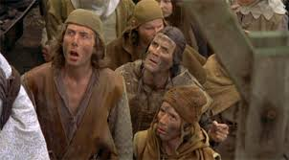
VOCABULARY

Slide 4
Oral and writting practice
Role play: one person plays a grandparent with hearing loss, another plays the grandchild who must repeat everything for the grandparent and a third person who will play a travel agent. The grandparent and the travel agent will have a conversation, but the grandparent won’t be able to hear anything the agent says. The grandchild must repeat everything for the grandparent using reported speech AND past perfect tenses. Have fun and be creative and, of course, raise your voices so they can be heard. Include new vocabulary.

Slide 5
Homework
Do reading on page 76. Answer exercise B and C.
Continue studying new vocablary.
Complete workbook pages 48-52.

