Slide 1
That’s Strange
Module 5

Slide 2
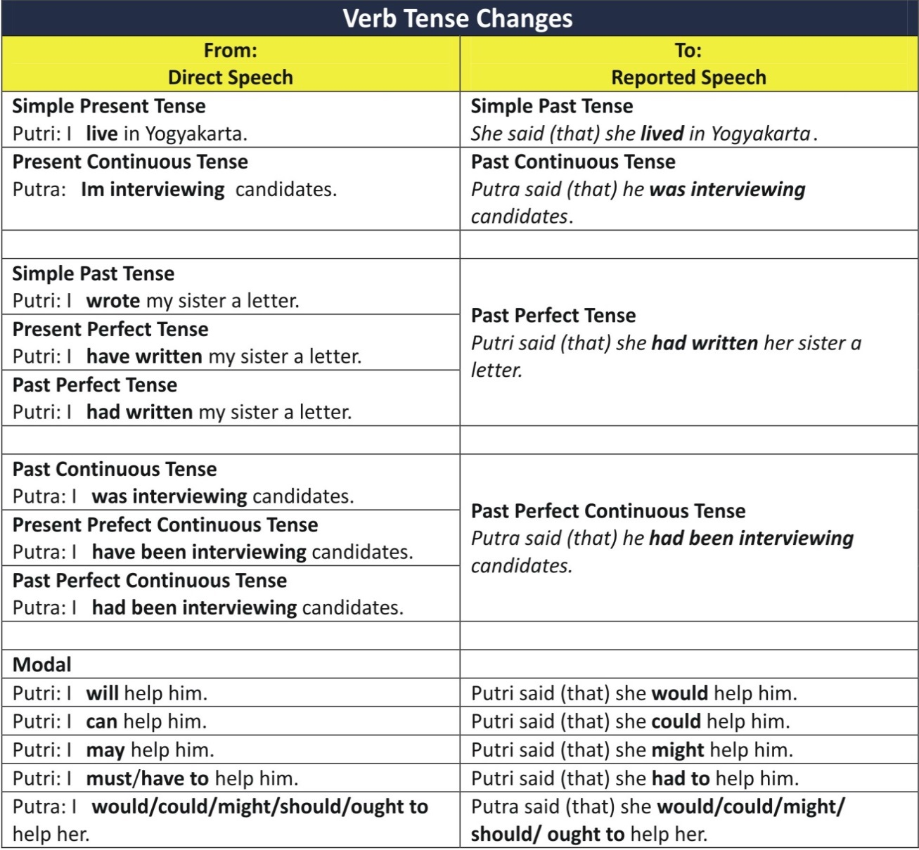
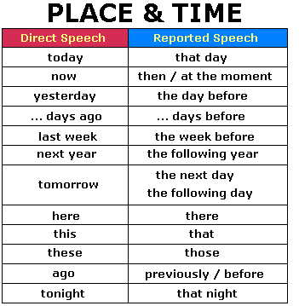
Reported speech
Direct speech | Indirect speech / Reported Speech
Mary: 'The girls helped in the house last week.' | Lin: Mary told me that the girls had helped in the house the week before.

Slide 3
Introductory Verbs
Statements
She said to me that
She told me that
Commands
He told her
Requests and questions
She asked him
I wondered
They wanted to know

Slide 4
Reported speech commands
Direct speech | Indirect speech / reported speech
ANAID: 'Don't play football in the garden!' | Janet: Anaid told me not to play football in the garden.
Marissa: ´Get in the car!’ | Larissa: Marissa told me to get in the car.
jump on the bed
drive carefully
eat slowly
speak clearly

Slide 5
Reported Speech questions
Direct Speech | Indirect Speech / Reported Speech
Ana :'Do you want to dance?' | Valery: Ana asked me if I wanted to dance.
DENNISE:'Did you watch the latest film?' | Montse: Dennise asked me if I had watched the latest film.
Direct Speech | Indirect Speech / Reported Speech
LARISSA:'What are you doing?' | Arely: Larissa asked me what I was doing.
MONTSERRAT:'When did you come?' | Yolanda: Montse wanted to know when I had come.
Have gone skiing
do yesterday

Slide 6
Oral and writing practice
Role play: one person plays a grandparent with hearing loss, another plays the grandchild who must repeat everything for the grandparent and a third person who will play a travel agent. The grandparent and the travel agent will have a conversation, but the grandparent won’t be able to hear anything the agent says. The grandchild must repeat everything for the grandparent using reported speech.
Have fun and be creative and, of course, raise your voices so they can be heard. Include new vocabulary, one statement, one command, one request and one question.

Slide 7
Home work
Complete the Reported Speech ( commands, questions and requests) activities from your work book pages in Module 5.

