Slide 1


Click on the following link to watch the use of going to.
https://www.youtube.com/watch?v=G7YVSmpDFZQ

Slide 2
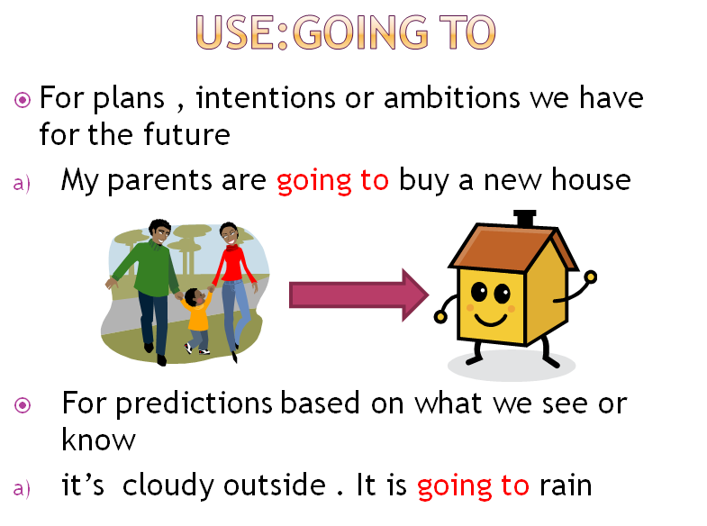

Slide 3
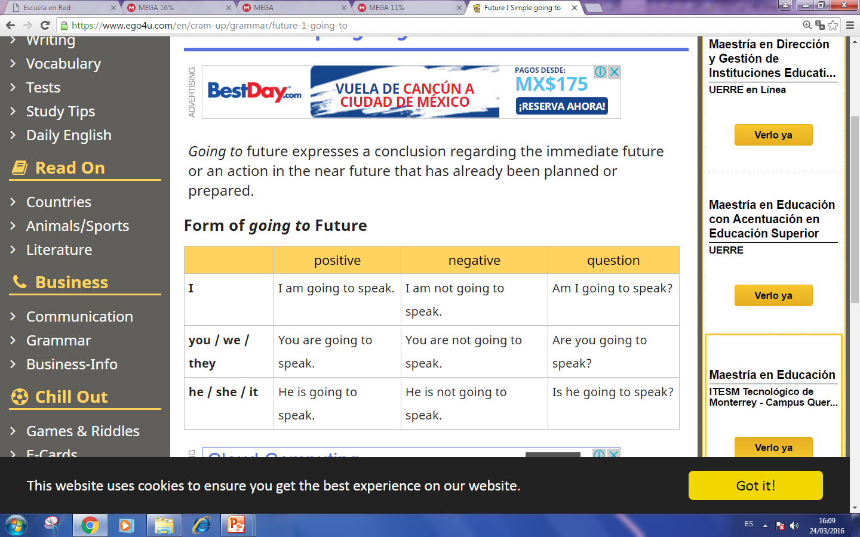
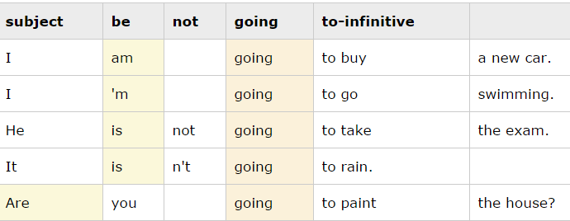
positive | negative | question | Wh questions
I am going to play. You are going to play. He is going to play. | I am not going to play. You are not going to play. He is not going to play. | Am I going to play? Are you going to play? Is he going play? | What where when how long why | Am Are Is | I you we they he she it | Going to | Play?

Slide 4
Write positive sentences in going to future.
I / work -
you / dance -
it / rain -
they / ask -
he / stays -
we / speak -
I / give -
she / try -
they / help -
he / push -

Slide 5
Write negative sentences in going to future.
(I / sell / my car)
(he / help / us)
(they / study / harder)
(we / cook / dinner tonight)
(I / celebrate / my birthday this year)
(she / clean / her room)
(they / move / house)
(she / stay / with Amy)
(they / change / their clothes)
(we / get up early / next Sunday)

Slide 6
Write questions in going to future.
(he / cook dinner / tonight)
(you / run / in the race)
(they / climb / that mountain)
(she / exercise / at the gym / in the afternoon)
(you / carry / that heavy box)
(computer / crash)
(we / eat / fish / tonight)
(he / play football / tomorrow)
(Lucy / call / a taxi)
(you / sing / a song / for us)

Slide 7
Make informative questions to the answers below using these words to start:
WHAT - WHERE - WHEN - WHO - WHY - WHO
1. _________________________________________________________________ ?
She is going to study Law next year.
2. ___________________________________________________________________ ?
Philip and Sam are going to go to Paris.
3. ___________________________________________________________________ ?
No, I'm not. I'm not going to study at home. I'm going to study at the Library.
4. ___________________________________________________________________ ?
I am going to give up smoking because it is bad for me.
5. ___________________________________________________________________ ?
Mary is going to bring a cake.

