Slide 1
Escuela Normal de Educación Preescolar
Inglés B1-
Module 2
“Believe it or not”
Docente: Alejandra Gaona García
Alumnas: María Lidia Monserrath Lizcano Sifuentes
Karina Arízbeth Pérez Salas
Grado: 3° Sección: “A”
November 21st.

Slide 2
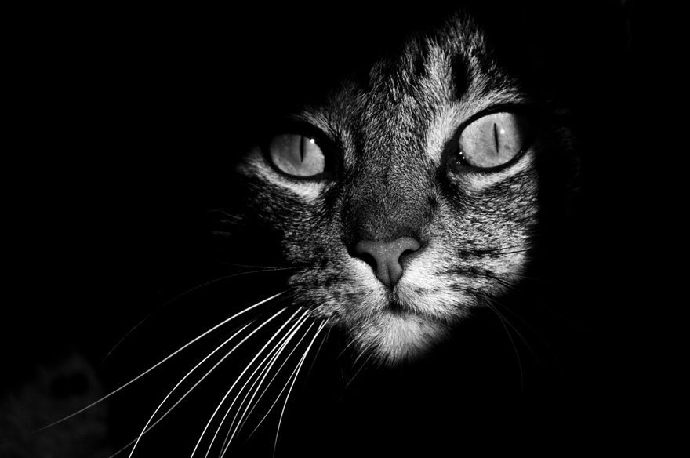
My Scary Cat

Slide 3
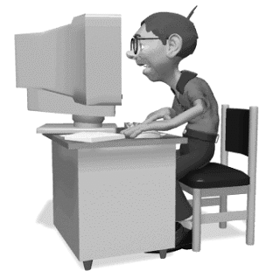
When I was 16 years old, everyday a eleven p.m. I played Mario Bros video games.

Slide 4
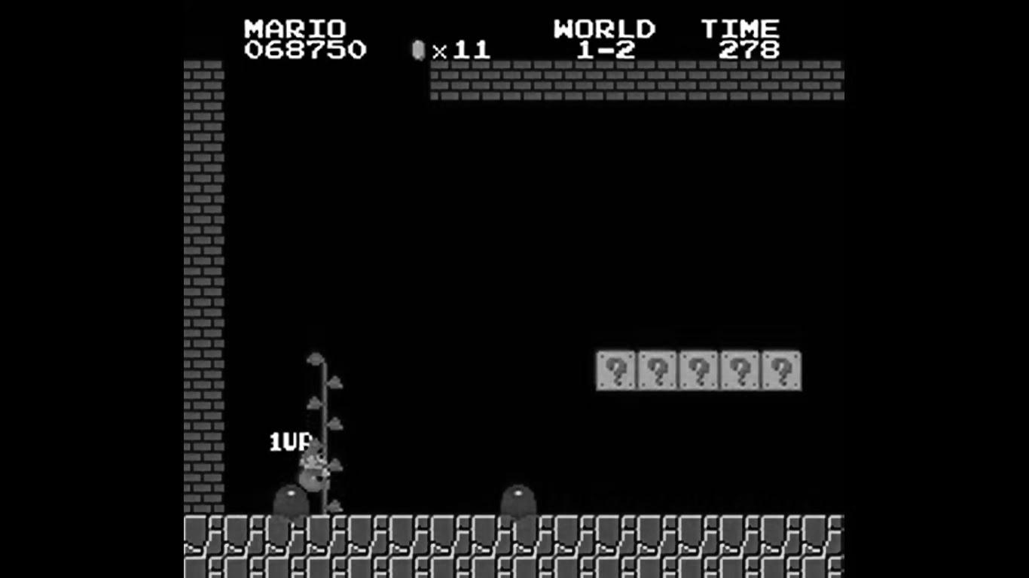
One day I was going very fast levels when suddenly the lights went out but the computer was still turned on I was scared it and I had to turn and sabe all.

Slide 5
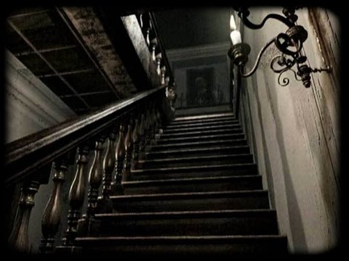
I stood up and went up to my room, unfortunately when i went up the stairs there was a strange noise!
As if someone was following me!

Slide 6
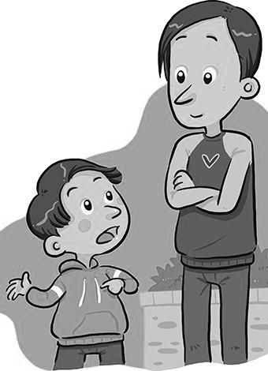
I ran to the bedroom of my parents telling them everything that had happened.
My dad and my mom wake up and went downstairs to see if there was nobody in the house.

Slide 7
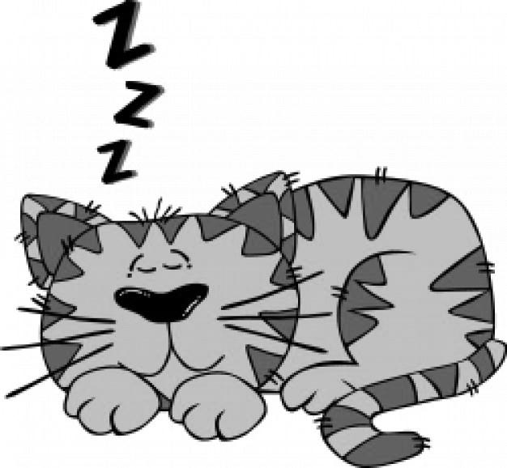
Fortunately inside my house was my sleeping cat next to the light domper and every time he moved, it the lights went out.

Slide 8
When i had felt someone following him, it was my cat when he had awakened.
I felt calm knowing the truth.

Slide 9
The End

