Slide 1
ESCUELA NORMAL DE EDUCACION PREESCOLAR
CICLO ESCOLAR 2016-2017
Module 2 Traveller PRE-INTERMEDIATE
“ BELIEVE IT OR NOT”
Competencia a desarrollar: Utilizar la lengua para expresar conceptos propios de la unidad.
Aprendizaje esperado: Utilizar la gramática de manera correcta de la unidad : pasado progresivo, pasado simple vs pasado progresivo, utilizar adjetivos con ing/ed, Adverbs and adverbial phrases (suddenly, finally, fortunately, etc..) cláusulas de tiempo (while, as son as, etc.., )Presente perfecto, además del vocabulario y funciones del lenguaje del MÓDULO 2
Rasgos o competencias del perfil de egreso:
Aplica sus habilidades comunicativas en diversos contextos.
O Desarrolla sus habilidades comunicativas para adquirir nuevos lenguajes.
O Utiliza una segunda lengua para comunicarse.
Emplea las tecnologías de la información y la comunicación.
O Participa en comunidades de trabajo y redes de colaboración a través del uso de la tecnología.
2 B
3er año
5TO SEMESTRE
Integrantes:
LOPEZ DENA ROXANA ARACELY
MORON PEREZ DEYANIRA

Slide 2
One day i was sleeping, dreaming that i climbed the chocolate sparks of a sweet cake

Slide 3
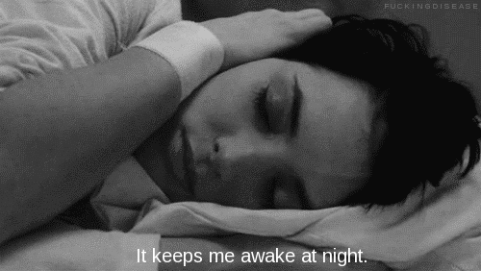
when suddenly i heard a noise, so as usual

Slide 4
I armed myself of value and decided to investigate what happened.

Slide 5
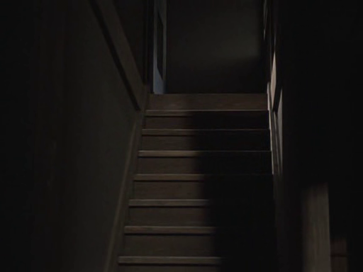
As i went down the steps, i saw a light and i started following her.

Slide 6
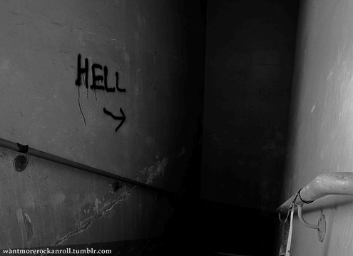
As soon as i reach the 1st floor, i felt something that i walked between my legs, Of course i gave me goosebumps,

Slide 7
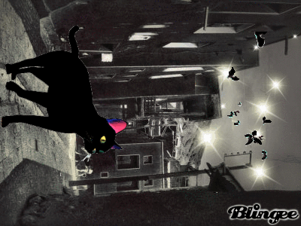
luckily and as always it was my cat Angus.

Slide 8
I started to go my way when my cell phone suddenly rang, i was scared, they were twice in a row, the good thing is that i was on vibrator, i ignored it and ifollowed

Slide 9
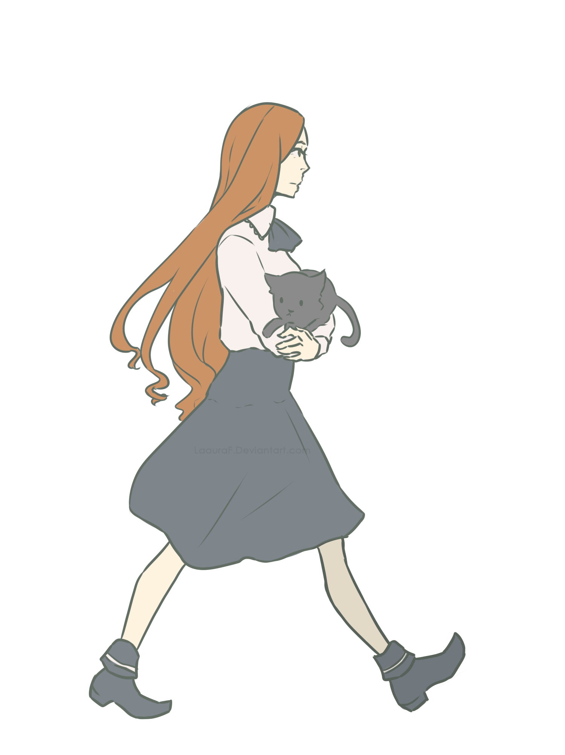
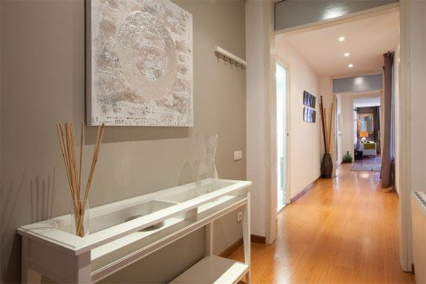
Walk to the kitchen

Slide 10
As soon as you reach the door i heard someone was on the other side

Slide 11
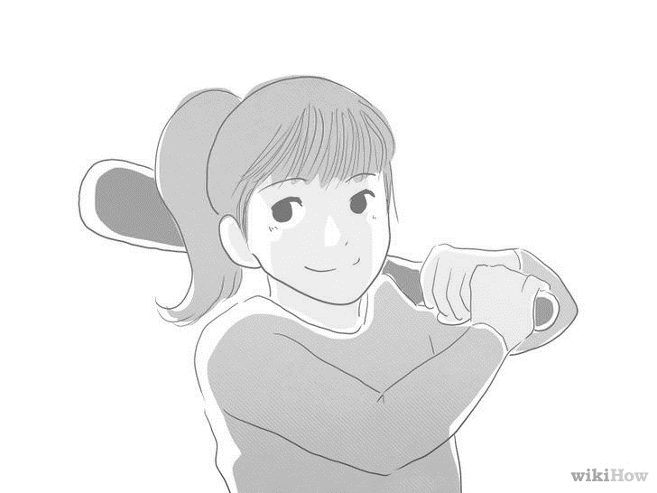
First take a look and i saw a shadow approaching towards me i finally decided and take a baseball bat with all my strength… …

Slide 12
Was ready to defend me, when by surprise when i opened the door

Slide 13
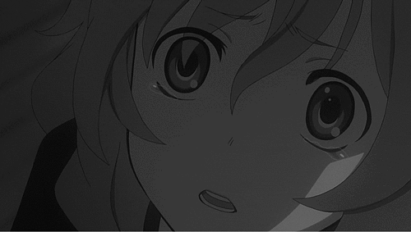
I saw the pale face of my roommate.

Slide 14
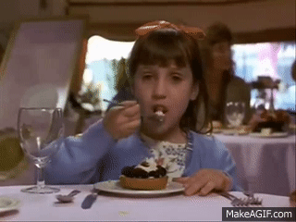
Eating a sweet chocolate cake, fortunately was she,

Slide 15
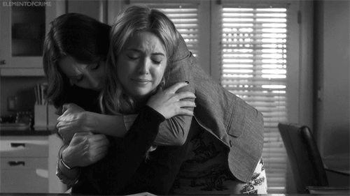
Who had arrived of your hiking 3 days earlier than expected, which she never did and from that day my friend does not hesitate to give advance notice of her arrival.

Slide 18
One day i was sleeping, dreaming that i climbed the chocolate sparks of a sweet cake, when suddenly i heard a noise, so as usual i armed myself of value and decided to investigate what happened. As i went down the steps, i saw a light and i started following her. As soon as i reach the 1st floor, i felt something that i walked between my legs, of course i gave me goosebumps, luckily and as always it was my cat Angus. i started to go my way when my cell phone suddenly rang, i was scared, they were twice in a row, the good thing is that i was on vibrator, i ignored it and i followed. Walk to the kitchen as soon as you reach the door i heard someone was on the other side, i finally decided and take a baseball bat with all my strength… Was ready to defend me, when by surprise when i opened the door i saw the pale face of my roommate, eating a sweet chocolate cake, fortunately was she, who had arrived of your hiking 3 days earlier than expected, which she never did and from that day my friend does not hesitate to give advance notice of her arrival.

