Slide 2
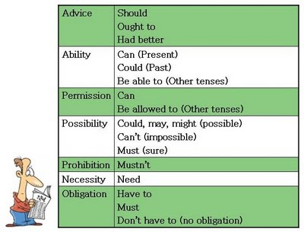

Slide 3
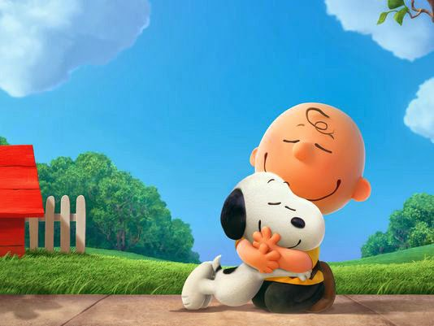
Imagine the best society to live in.
You must write ten rules for your Utopia (use 5 modal verbs).
Place the rules on the wall and the class will vote for their favorite society.

Slide 4
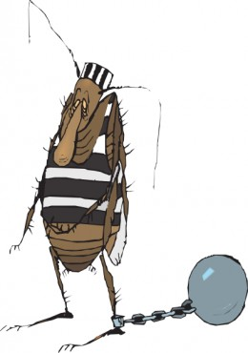
Imagine the worst society to live in.
You must write ten rules for your Utopia (use 5 modal verbs).
Place the rules on the wall and the class will vote for their favorite society.

Slide 5
http://www.better-english.com/grammar/mustnt.htm

Slide 6
mustn't / don't have to
Match the items on the right with the items on the left.
It is forbidden. You ______ do that.
You ______ ask my permission. You can do what you want.
You ______ speak to the driver when the bus is moving. It's dangerous.
Help yourself to anything you want. You ______ ask.
You ______ park here. There is a double yellow line.
Pay me back when you can. You ______ do it immediately.
It's optional. We ______ to go if you don't want to.
I'll tell you a secret. You ______ tell anybody else. Promise?
Whatever you do, you ______ click with the right mouse button or the program will crash.
Be on time. You ______ be late or we will leave without you.
He's a millionaire. He ______ work but he does because he enjoys it.
I like Saturdays because I ______ go to work.
This is very important. You ______ forget what I said.
It's very infomal here. You ______ wear a tie unless you want to.
The train is direct. You ______ change trains.
In boxing, you ______ hit your opponent below the belt.
I ______ wear a suit at work on Fridays. It's 'dressing down day".
In athletics, you ______ start before the gun is fired.
In bridge, you ______ look at other people's cards.
You ______ be mad to work here but it helps.
Your score is

