Slide 1
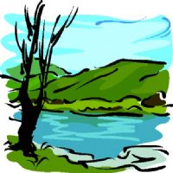
MEET THE NATURE…..
Geographical features….
Click for vocabulary explanation
https://www.youtube.com/watch?v=3nm0NotMNfI
http://www.languageguide.org/anglais/vocabulaire/paysage/

Slide 2
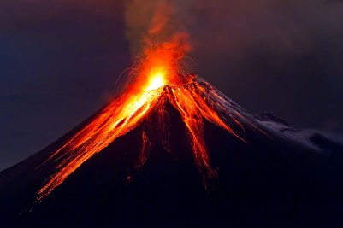
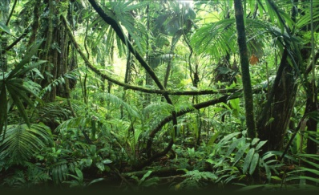
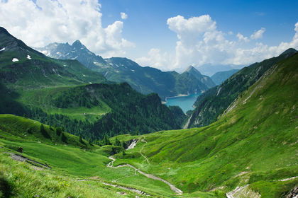
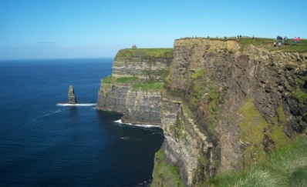
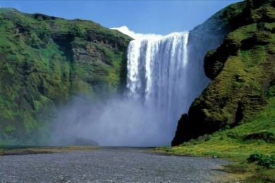
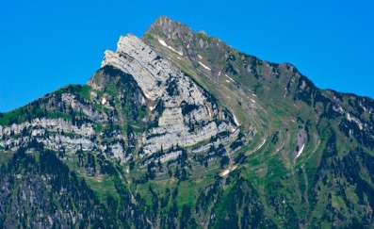
Match the picture with the correct description in the excercise below.
is a landform made from rocks and earth usually have peak shape.
is a vertical, or near vertical, rock exposure, are common on coasts or along rivers.
are openings in the Earth’s surface. When they are active they can let ash, gas and hot magma escapes.
is a river or other body of water's steep fall over a rocky ledge into a plunge pool below.
are home to a wide range of wild plants and animals.
It is a V-shaped depression generally between two ranges of hills.

