Slide 1
Click on the link to watch explanation
https://www.youtube.com/watch?v=CVLmpQBwM3c

Slide 2
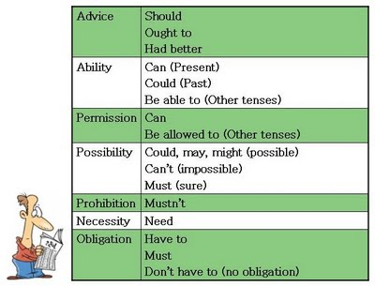
Click on the following link for a better explanation
http://www.perfect-english-grammar.com/modal-verbs.html

Slide 3
Can, Could, May and Might Exercise
http://perso.wanadoo.es/autoenglish/gr.may.p.htm
Must-have to-need to Exercise
http://www.grammarbank.com/must-vs-need-to-have-to.html
Modal auxiliary verbs Exercise
http://esl.fis.edu/grammar/multi/modal1.htm
A game with modal auxiliary verbs to practice
http://www.eslgamesplus.com/modal-verbs-can-could-might-must-should-would-catapult/

