Slide 1
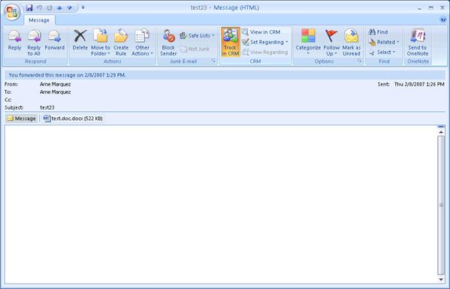
Write an e-mail to a friend giving him/her information about your future plans for holidays (include at least 10 structures with going to +,-,?, wh?)

