Slide 1
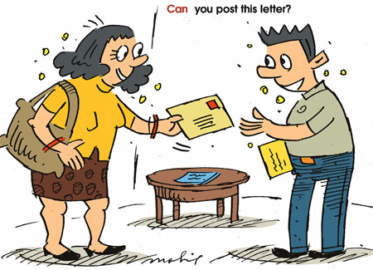
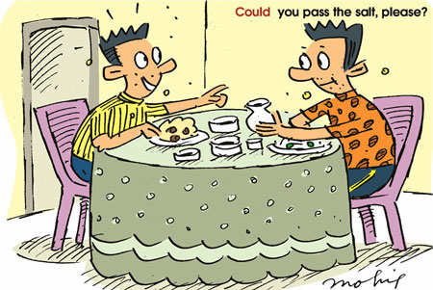

Slide 3
Draw a commic with a conversation using modals
Answer exercises A,C,D workbook pgs 58-59

