Slide 1
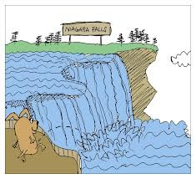
Niagara Falls form a (natural / naturally) border between the United States and Canada.
Tourists visit (frequent / frequently) this place .
The Falls are very ( noisy / noisily ).
So you must speak (loud / loudly) or nobody can understand you.
Many years ago, the Iroquois tribe lived here (peaceful / peacefully ).
Choose the correct form (adjective or adverb).

Slide 2
Click on this link to see the introduction to "Adverbs"
https://www.youtube.com/watch?v=b4KybdSi1Fc
Click on the following link to play a game with adverbs
http://www.brainpopjr.com/readingandwriting/word/adjectivesandadverbs/scrollingbackground/

