Slide 1

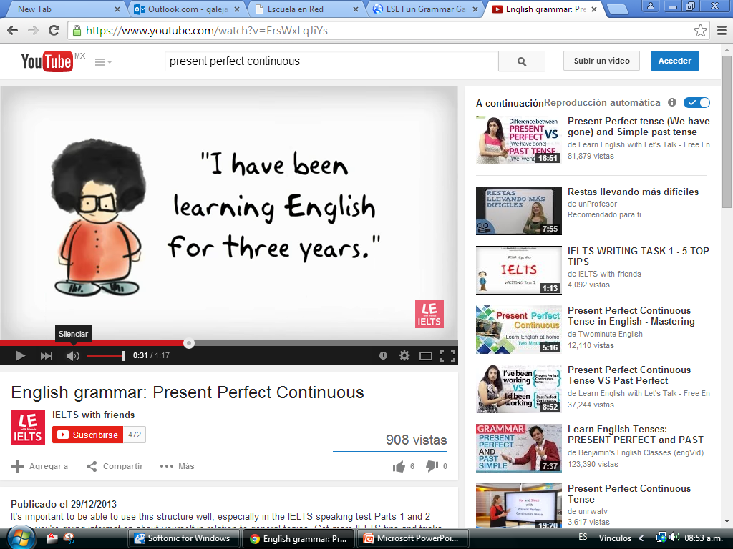
Click on the following link to watch the present perfect progressive introduction
https://www.youtube.com/watch?v=FrsWxLqJiYs

Slide 2
The structure of the Present Perfect Continuous tense is:
subject | + | auxiliary have | + | auxiliarybe | + | main verb
 |  | conjugated in Present Simple |  | past participle
 |  | have, has |  | been |  | present participle
 | subject | auxiliary verb |  | auxiliary verb | main verb
+ | I | have |  | been | waiting | for one hour.
+ | You | have |  | been | talking | too much.
- | It | has | not | been | raining.
- | We | have | not | been | playing | football.
? | Have | you |  | been | seeing | her?
? | Have | they |  | been | doing | their homework?

Slide 3
1: To say how long for unfinished actions which started in the past and continue to the present. We often use this with for and since. (See thepresent perfect for the same use with stative verbs)
I've been living in London for two years.
She's been working here since 2004.
We've been waiting for the bus for hours.
2: Actions which have just stopped (though the whole action can be unfinished) and have a result, which we can often see, hear, or feel, in the present (focus on action). (See the present perfect for a similar use which focuses on the result of the action)
I'm so tired, I've been studying.
I've been running, so I'm really hot.
It's been raining, the pavement is wet.
I've been reading your book, it's very good.
Click on the following link for more examples : https://www.youtube.com/watch?v=mWfDrPeBDl8

Slide 4
Clik on the following links and practice the present perfect progressive copy-paste your results
http://www.eslgamesworld.com/members/games/grammar/perfectpast/New/present%20perfect%20continuous.html
http://www.englishgrammarsecrets.com/presentperfectcontinuous/exercise1.html
http://www.englishgrammarsecrets.com/presentperfectcontinuous/exercise2.html
http://www.englishgrammarsecrets.com/presentperfectcontinuous/exercise3.html

