Slide 1

http://www.eslgamesplus.com/videos/this-these-that-those-sentences-esl-video-lesson/

Slide 2
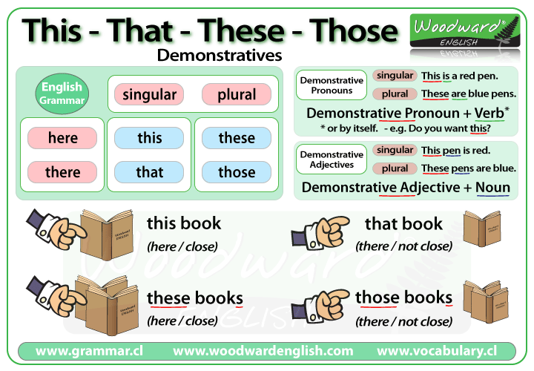

Slide 3
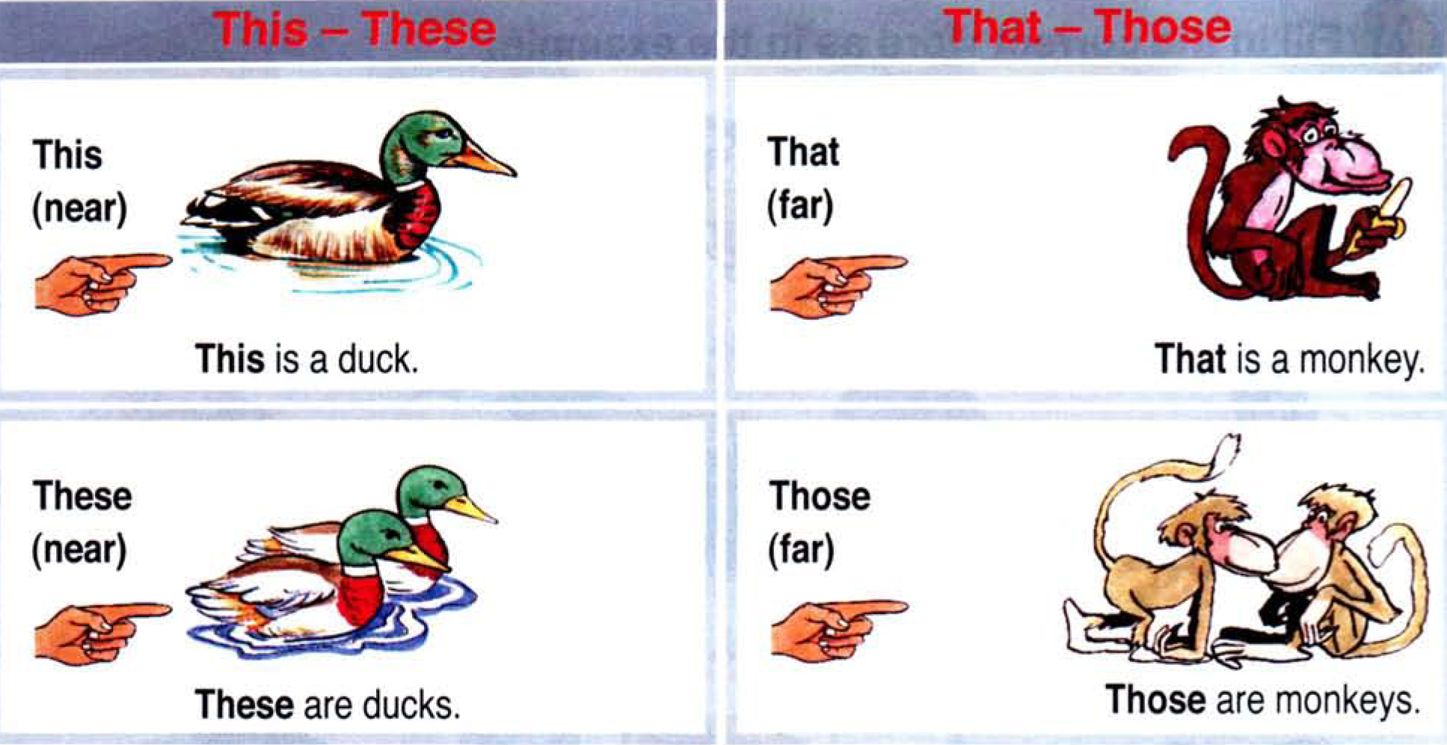

Slide 4
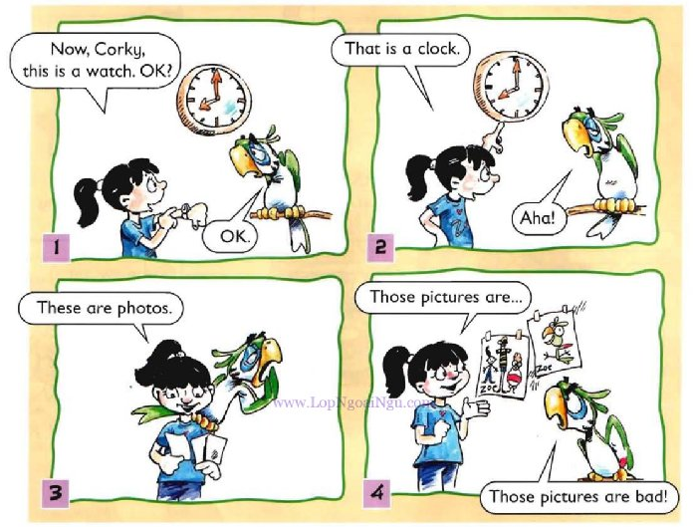

Slide 5
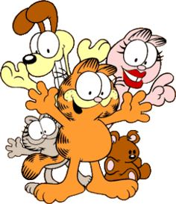
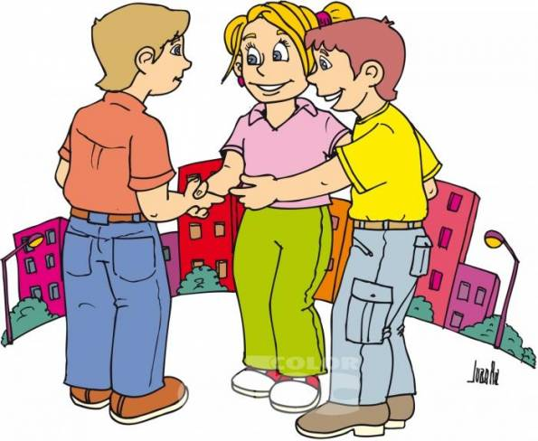
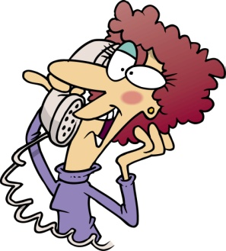
Demonstratives are also used…….
to introduce people:
This is Janet These are my friends
.
!!!!!WARNING!!!!!:
We don’t say These are John and Michael.
We say This is John and this is Michael
to introduce ourselves to begin a conversation on the phone:
Hello, this is David, Can I speak to Sally?

Slide 6
PRACTICE DEMOSNTRATIVES ON THE FOLLOWING WEBSITES.
CLICK ON THE LINK AND PRINT FINAL SCORE FOR EACH
http://www.eslgamesplus.com/videos/this-that-these-those-dialogue-esl-video/
http://www.freddiesville.com/games/this-that-these-those-demonstrative-pronouns-sentence-monkey-game/
http://www.grammar.cl/Games/This_That_These_Those.htm
http://learnenglishkids.britishcouncil.org/es/grammar-games/these-those

