Slide 1
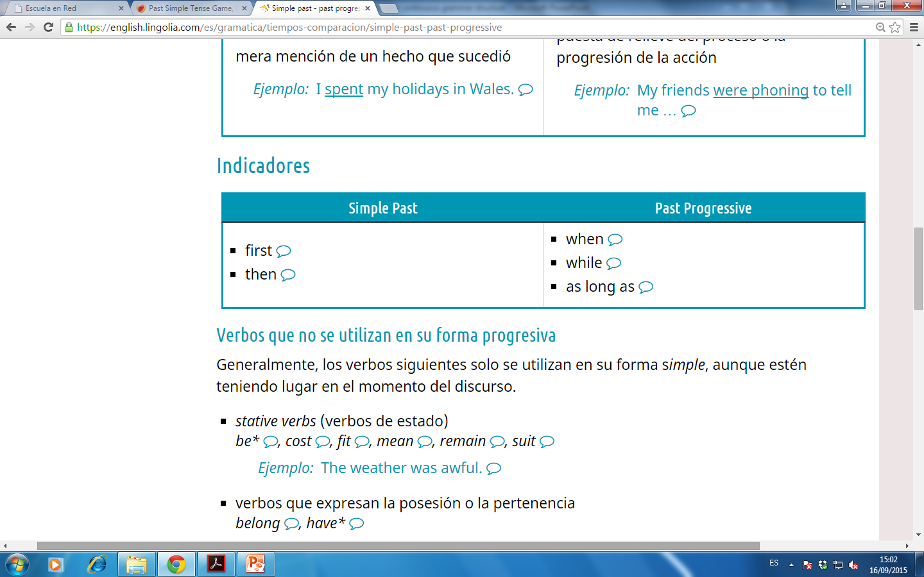
Use
Simple Past | Past Progressive
Action finished in the past Eg. I wrote a letter to Louis Past habits or actions repeated, completed in past(use advs. of frequency) Eg. He never studied for exams. An action in past that interrupted a longer action in past, or vice versa. Eg. I ate a veggie sandwich, I prepared it. | Action in progress at a special time in the past Eg. I was eating a sandwich, when he called me. Temporary actions Eg. My father was working for Chrysler automotive. Simultaneous actions in progress in past. Eg. We were sitting on the couch, while watching TV.
Indicators

Slide 2
Gramar Structure
Simple Past | Past Progressive
regular verbs: infinitive + -ed irregular verbs | (was or were) + infinitive + -ing
Possitive sentences
Simple Past | Past Progressive
I played football. | He was playing football.
You played football. | You were playing football.
He played football. | He was playing football.
Negative sentences
Simple Past | Past Progressive
I did not play football. | He was not playing football.
You did not play football. | You were not playing football.
He did not play football. | He was not playing football.
Questions
Simple Past | Past Progressive
Did I play football? | Was I playing football?
Did you play football? | Were you playing football?
Did he play football? | Was he playing football?

Slide 3
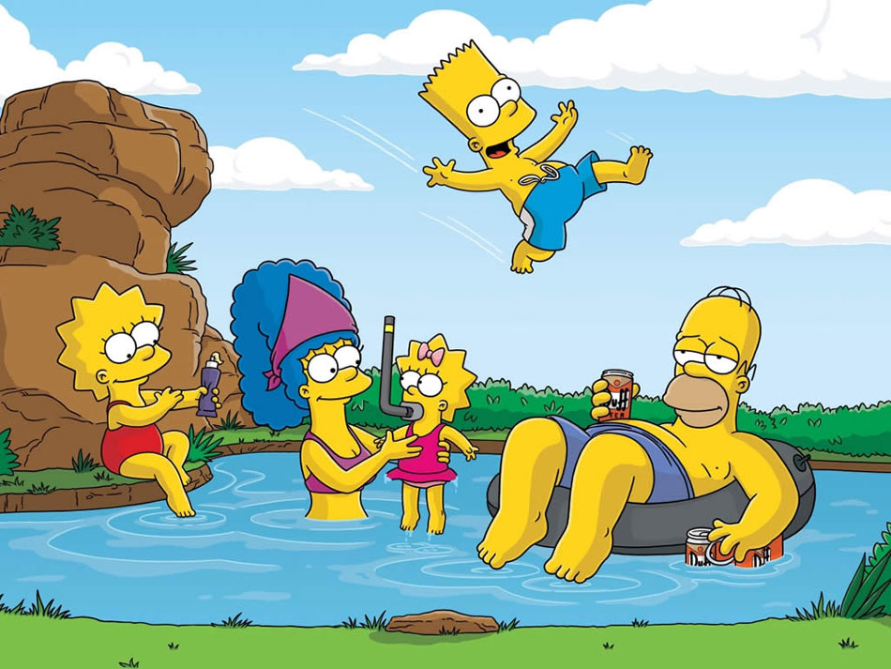

Slide 4
What were they doing?
Homer ___________________________________
Bart (-)____________________________________
Lisa______________________________________
Marge (-) __________________________________
They ____________________________________
Maggie (-)________________________________

Slide 5
Click on the following link and Practice simple past and past continuous
http://eslgamesworld.com/members/games/grammar/New_Snakes_%20Ladders/Past_tenses.html

