Slide 1
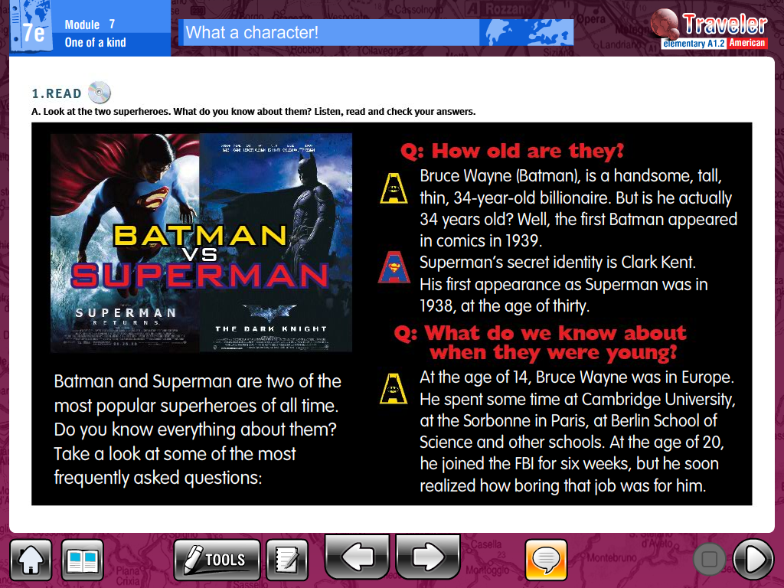
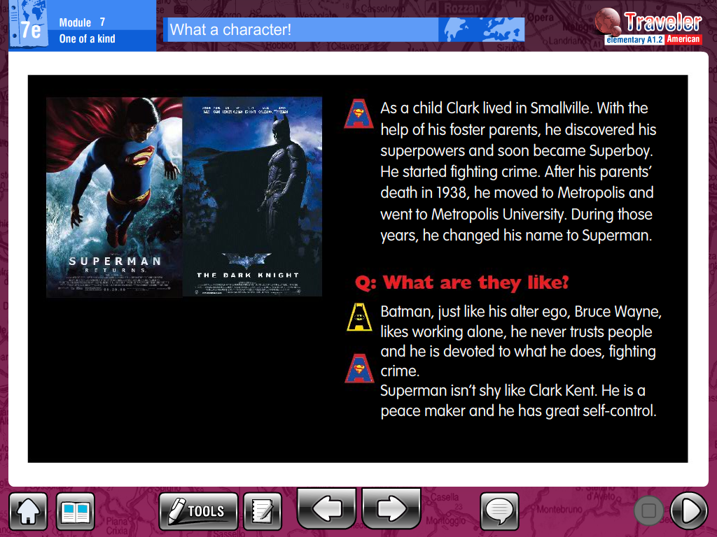

Slide 2
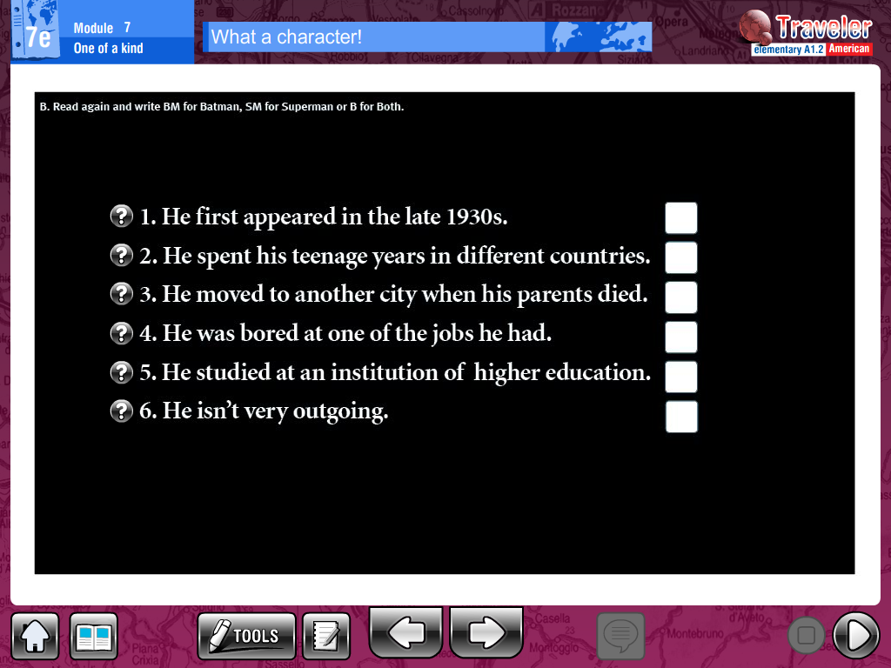
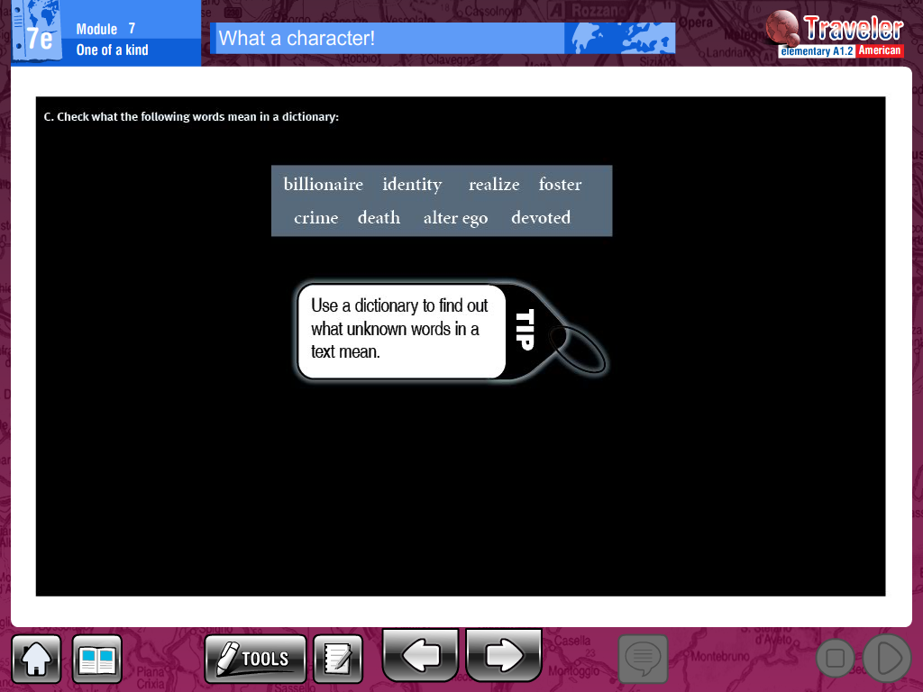
B. Read again and write BM for Batman, SM for Superman od B for Both
_____________________________________________________________________________________________________________________________________

Slide 3
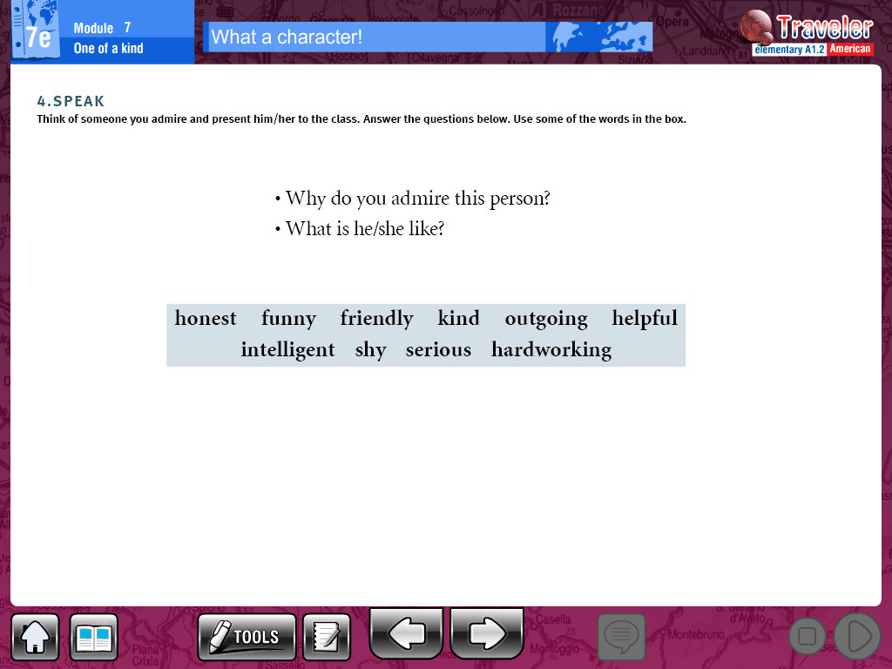
C. Think of someone you admire and present him/her. Answer the questions below. Use some words of the box.
___________________________________________________________________________________________________________________________________________________________________________________________________________________________________________________________________________________________________________________________________________________________________________________________________________________________________________________________________________________________________________________________________________________________________________________________________________________________________________________________________________________________________________________________________________________________________________________________________________________________________

