Slide 4
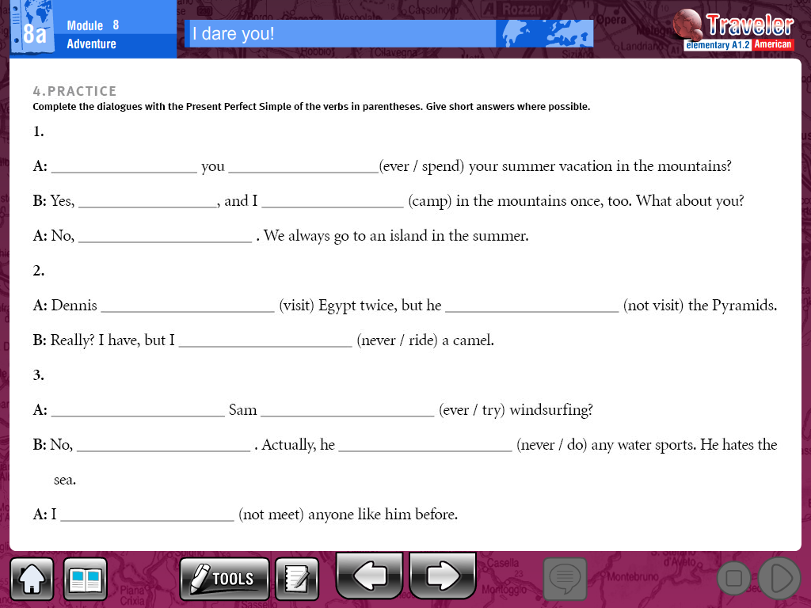

Slide 5
Write some questions in present perfect (giva an answer for them)
________________________________________________________________________________________________________________________________________________________________________________________________________________________________________________________________________________________________________________________________________________________________________________________________________________________________________________________________________

