Slide 1
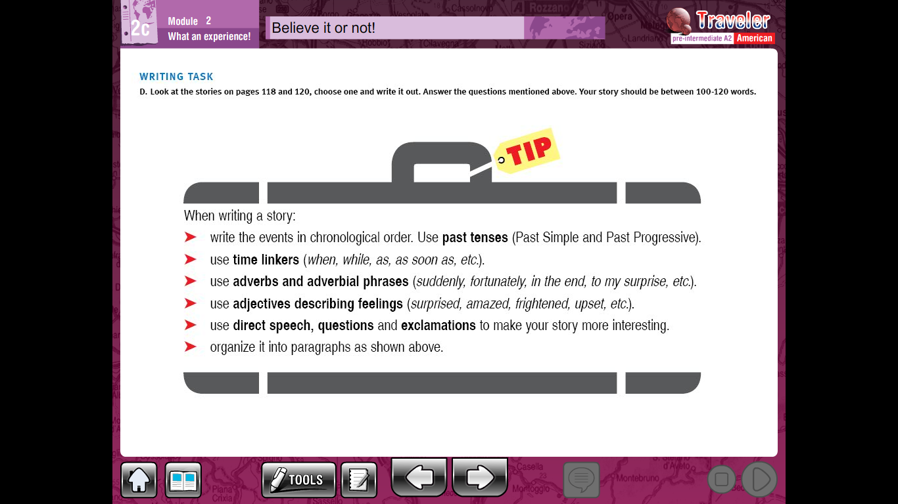
Writig task,
Look at the pictures on pgs 118 and 120 and invent a story remind to usethre following writing tips

Slide 2
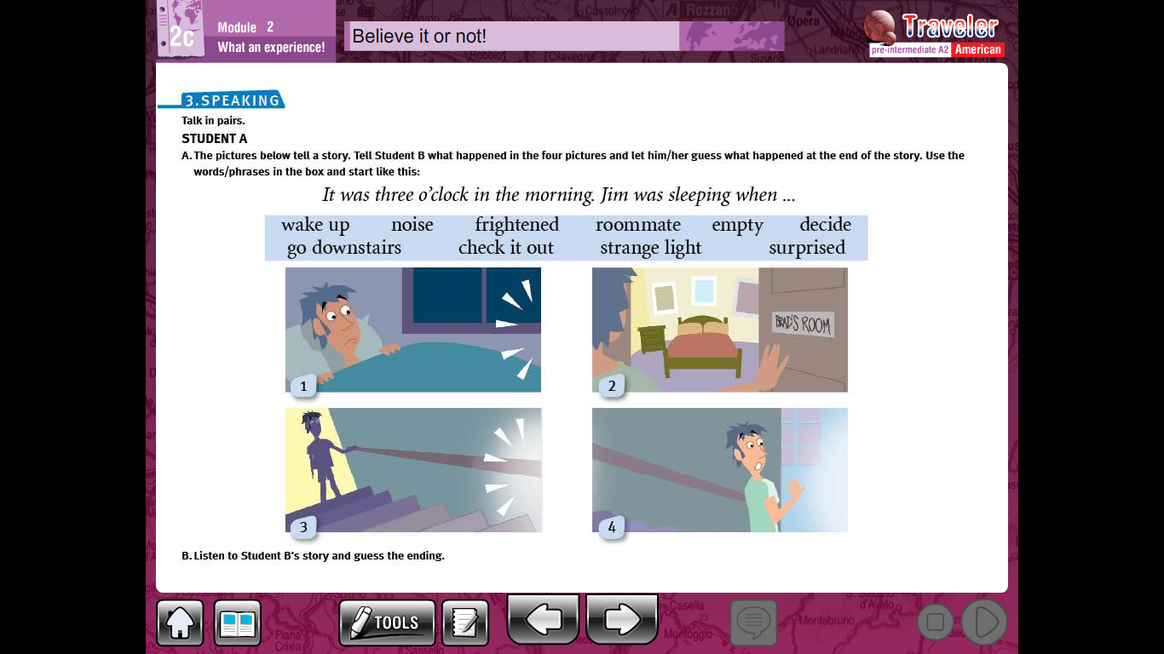
______________________________________________________________________________________________________________________________________________________________________________________________________________________________________________________________________________________________________________________________________________________________________________________________________________________________

Slide 3



