Slide 1
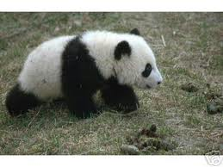
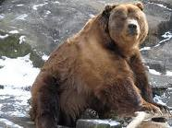
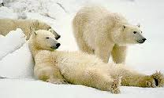
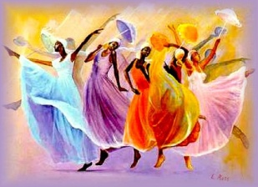
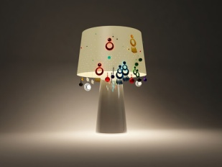
Example of superlatives
Grizzly bear
Panda bear
The grizzly is the biggest bear in the world
Polar bear
Example of intensifiers/qualifiers
This painting is too coloured
This lamp is not light enough

