Slide 1
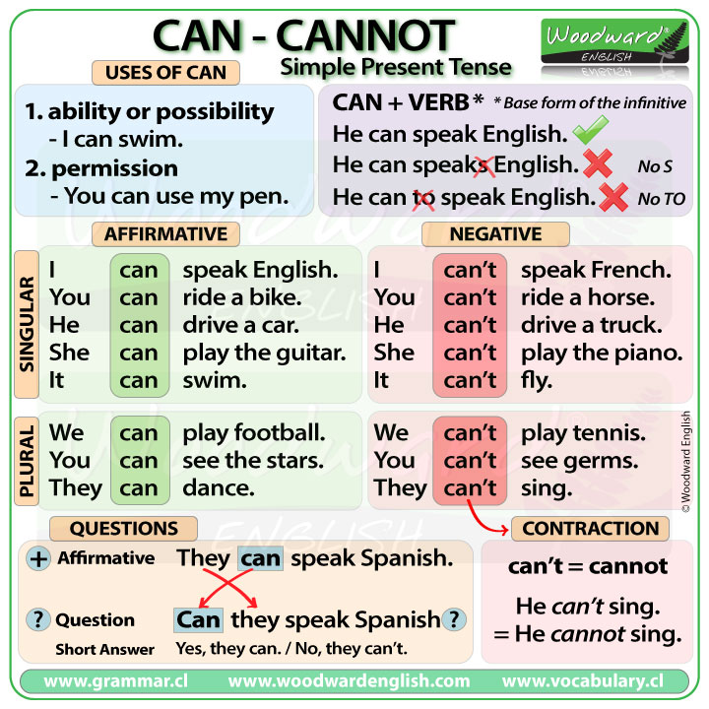
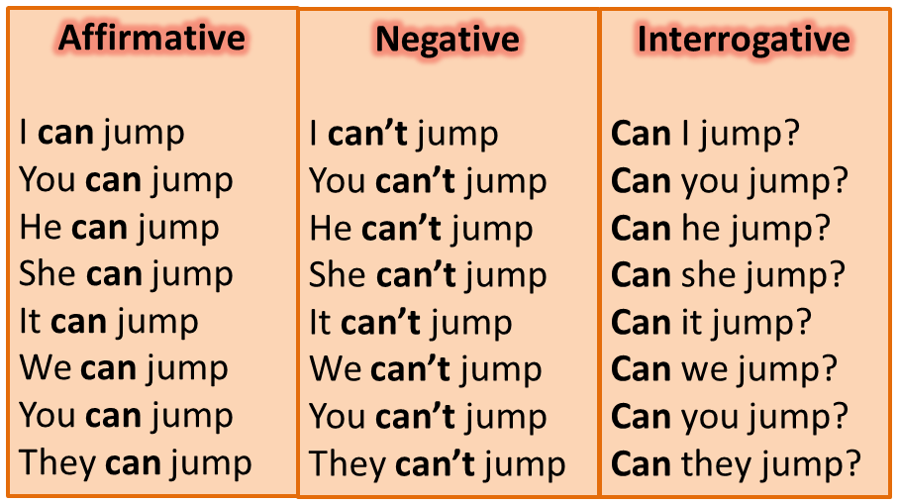
The use of Can – Can´t
Click on the following link to learn more about the use of can, can´´t
http://learnenglishkids.britishcouncil.org/en/grammar-practice/modals-can-and-cant

Slide 2
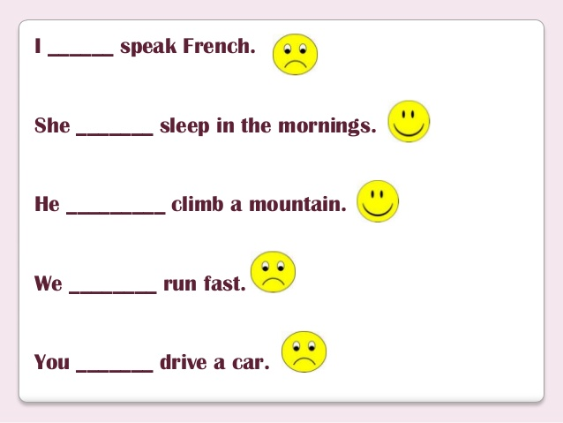

Slide 3
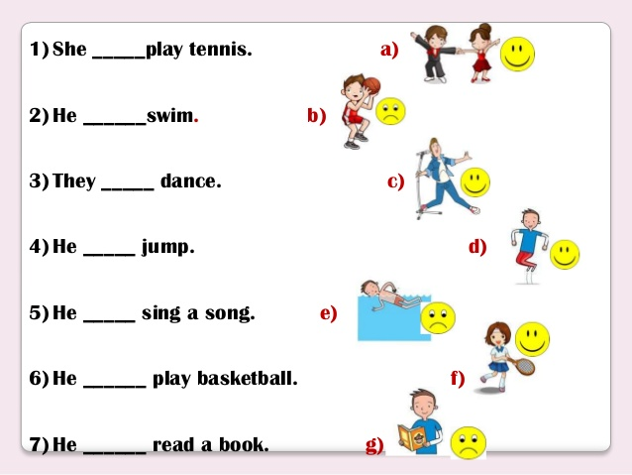

Slide 4
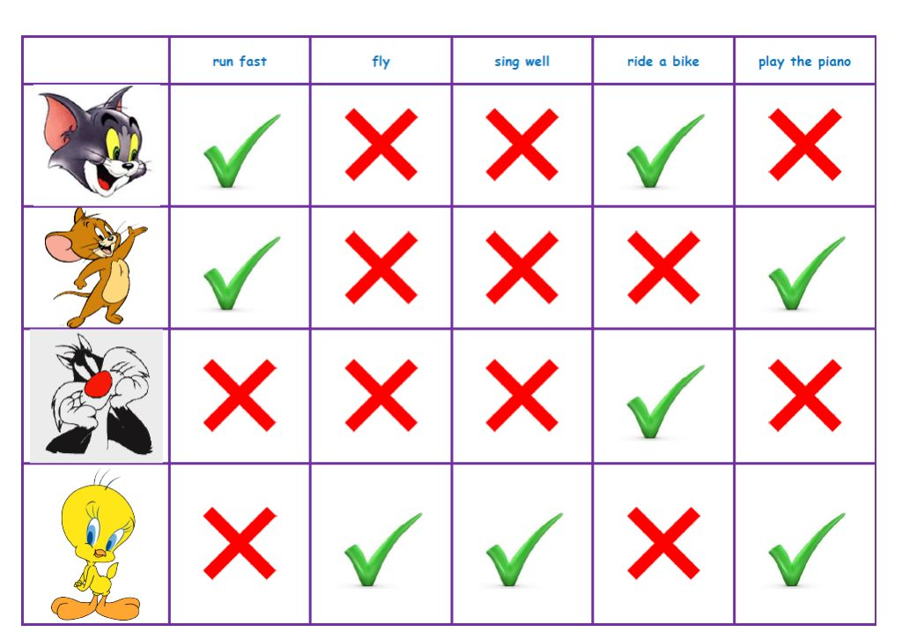



Use the chart to Write 6 sentences with can, can´t

