Slide 1
Simple past

Slide 2
Visit the following websites to better understand simple past
http://www.youtube.com/watch?v=AKaD2btS1A4
https://www.youtube.com/watch?v=QlZXd-m6Pdw

Slide 4
1.- Complete the following exercise with the simple past in positive and negative form
Last month (go) Went to England.
I Visited some museums, but I (not visit) Didn´t Visit the Zoo, I (take) Taked pictures of all the interesting places
I (eat) Ate in some famous restaurants, but I (not like) Didn´t like the food.
In the evenings I (go) Went to pubs and (meet) Met some handsome guys.
Of course, I (buy) Bought souvenirs for you.

Slide 5
2.- Find, underline and correct the mistakes in the following sentences
1.- They ate dinner at six ó clock yesterday.
2.- I didn´t finish my homework last night
3.- He didn´t go to bed early last night
4.- Sam visited Vancuver last month
5.- My friends played videogames in my house last sunday

Slide 6
Play a game with regular and irrgular verbs in past and print your results
Activity 2.- spelling game irregular verbs
http://www.eslgamesworld.com/members/games/grammar/perfectpast/New/past%20simple%20practice%20game.html
Activity 3.- maching regular and irregular verbs (2 games)
http://learnenglishkids.britishcouncil.org/en/grammar-practice/past-simple-sentences
Activity 4.- jeopardy irregular verbs
http://www.englishmedialab.com/GrammarGames/perfectpast/past%20simple%20betting.html
Activity 5.- hangman irregular verbs
https://www.eslgamesplus.com/practice-irregular-verbs-in-the-past-simple-esl-interactive-hangman/

Slide 7
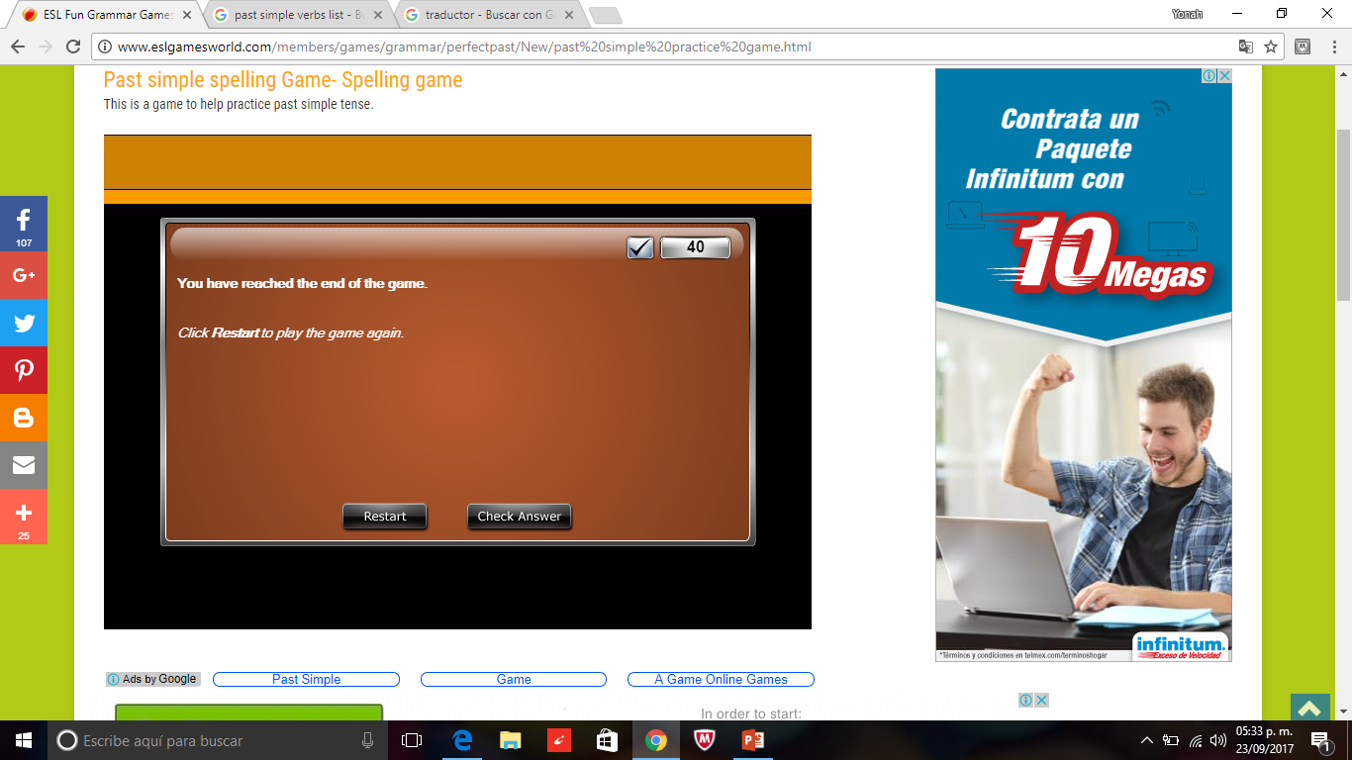
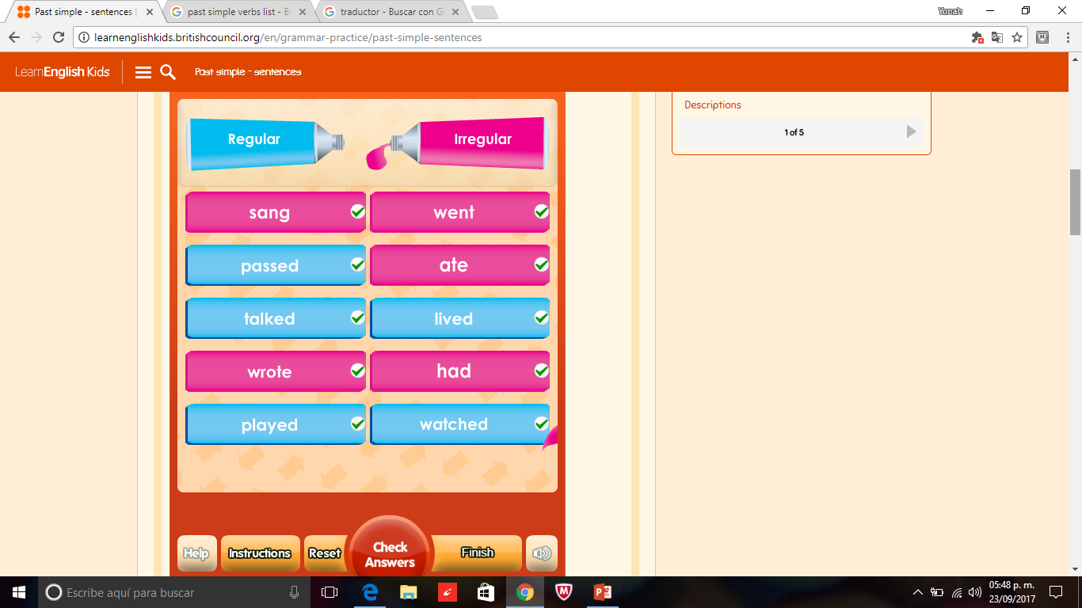
Activity 2.- spelling game irregular verbs
Activity 3.- maching regular and irregular verbs (game 1)

Slide 8
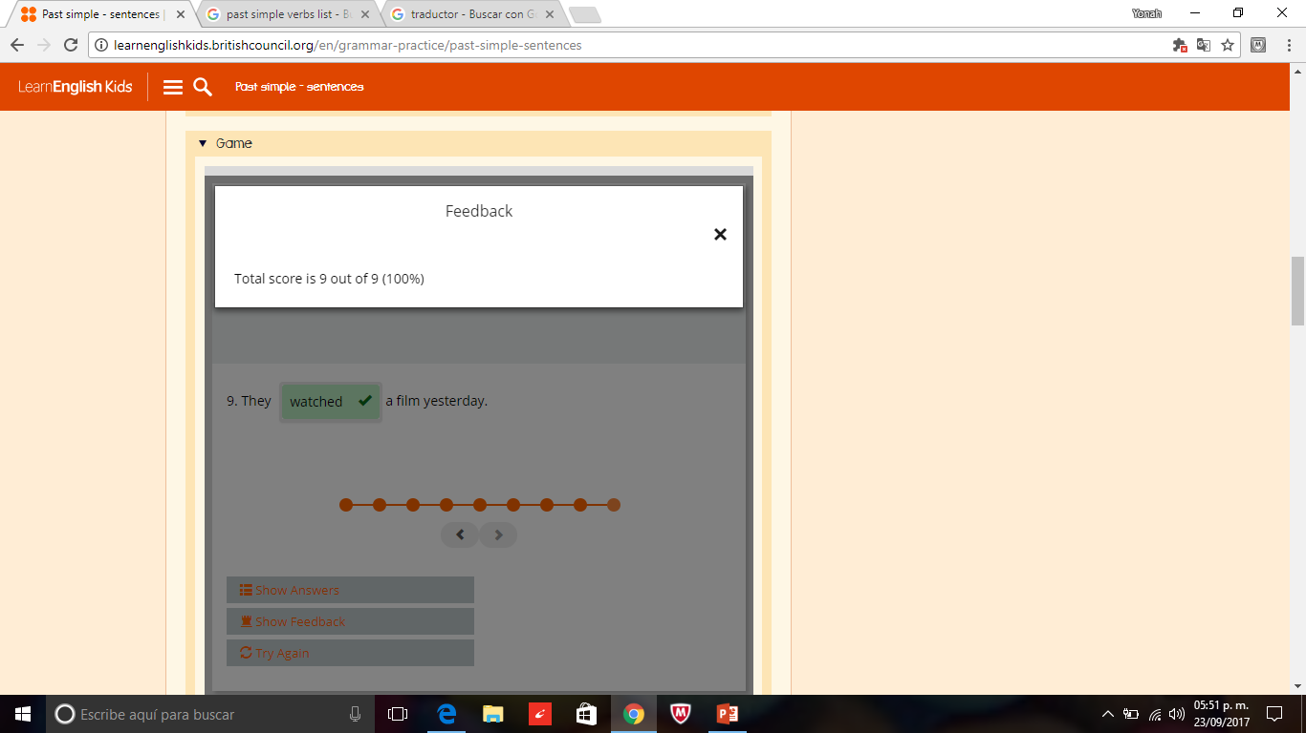
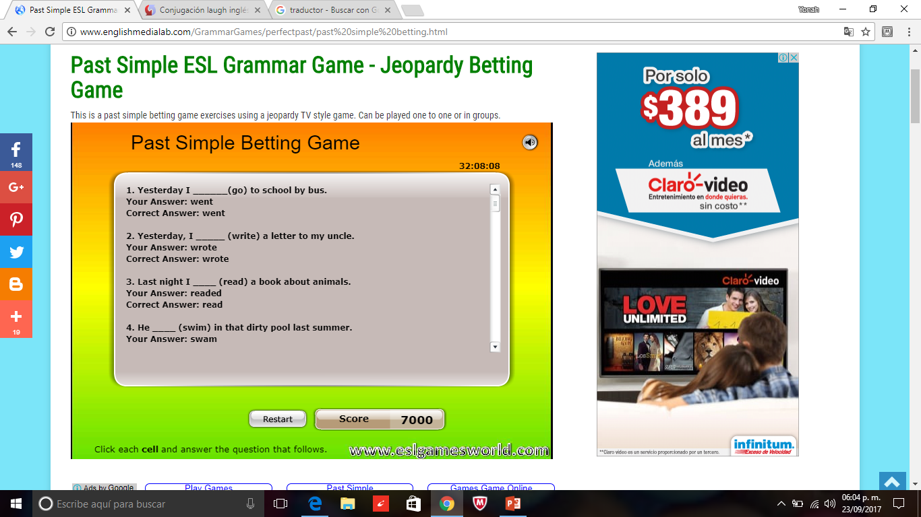
Game 2
Activity 4.- jeopardy irregular verbs

Slide 9
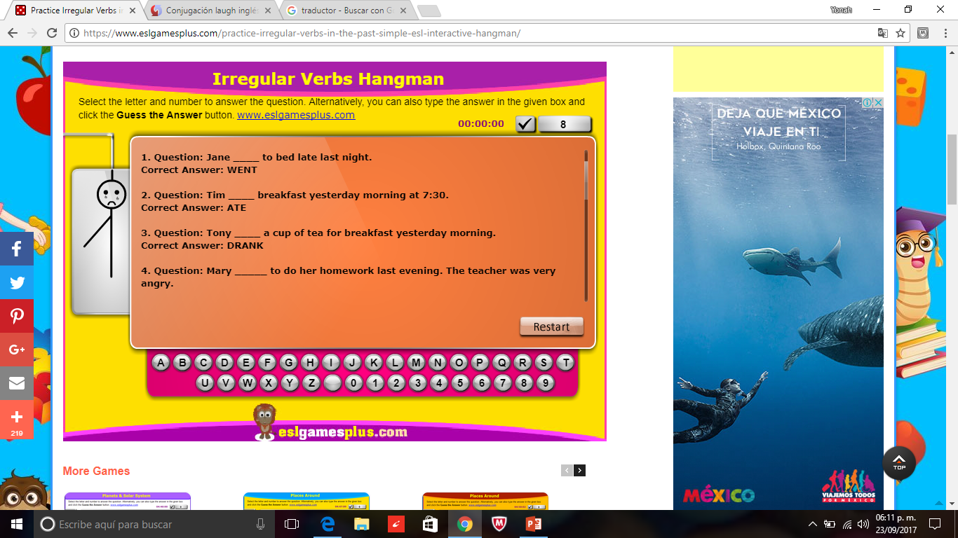
Activity 5.- hangman irregular verbs

