Slide 2
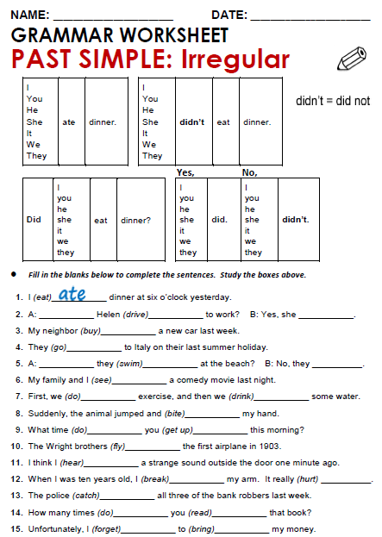

Slide 3
Answers the activity: Past simple: Irregular
2. Did, drive, did.
3. bought.
4. went.
5. Did, swim, didn´t.
6. saw.

Slide 4
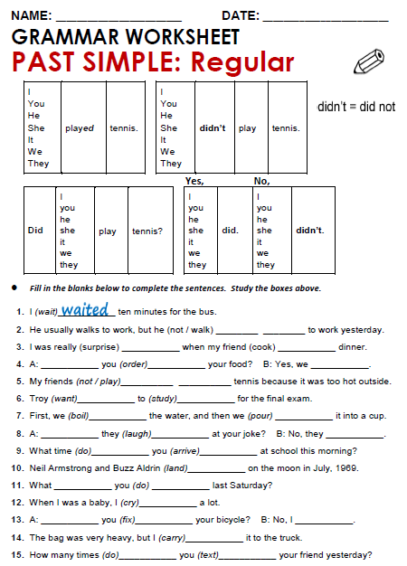

Slide 5
Answers the activity: Past simple: Regular
2. Didn´t walk
3. surprised, cooked.
4. Did, order, did.
5. Didn´t play.
6. Wanted, studied.

Slide 6
Practice simple past of irregular, possitive, negative and questions
http://www.eslgamesworld.com/members/games/grammar/New_Snakes_%20Ladders/Past_simple_tense.html
http://learnenglishkids.britishcouncil.org/en/grammar-practice/past-simple-sentences

