Slide 1
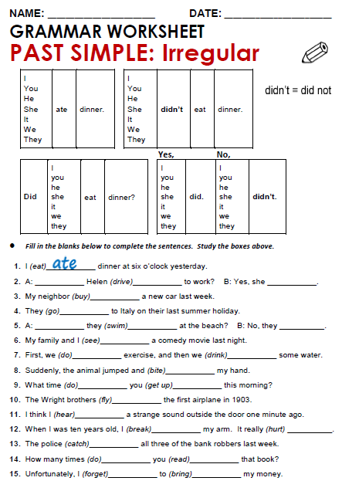

Slide 2
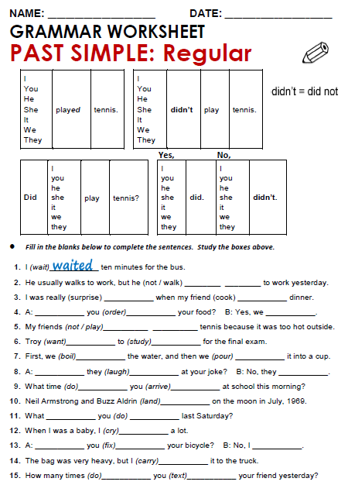

Slide 3
Fill in the blanks bellows to complete the sentences
PAST SIMPLE: IRREGULAR
A: Helen (drive) drove to work? B: Yes she does
My neighbor (buy) bought a new car last week
They (go) went to Italy on the last summer holiday.
A: Did they (swim) swam at the beach? No they didnt
My family and i (see) saw a comedy movie last nigth
Fill in the blanks bellows to complete the sentences
PAST SIMPLE: REGULAR
He usually walks to work, but he (not/walk) didn´t walk to work yesterday
I was really (surprise) surprised when my friend (cook) cooked dinner.
A: Did you (order) ordered your food? B: yes we did
My Friends (not/play) didn´t play tennis because it was to hot outside
Troy (want) wanted to (study) studied for the final exam

Slide 4
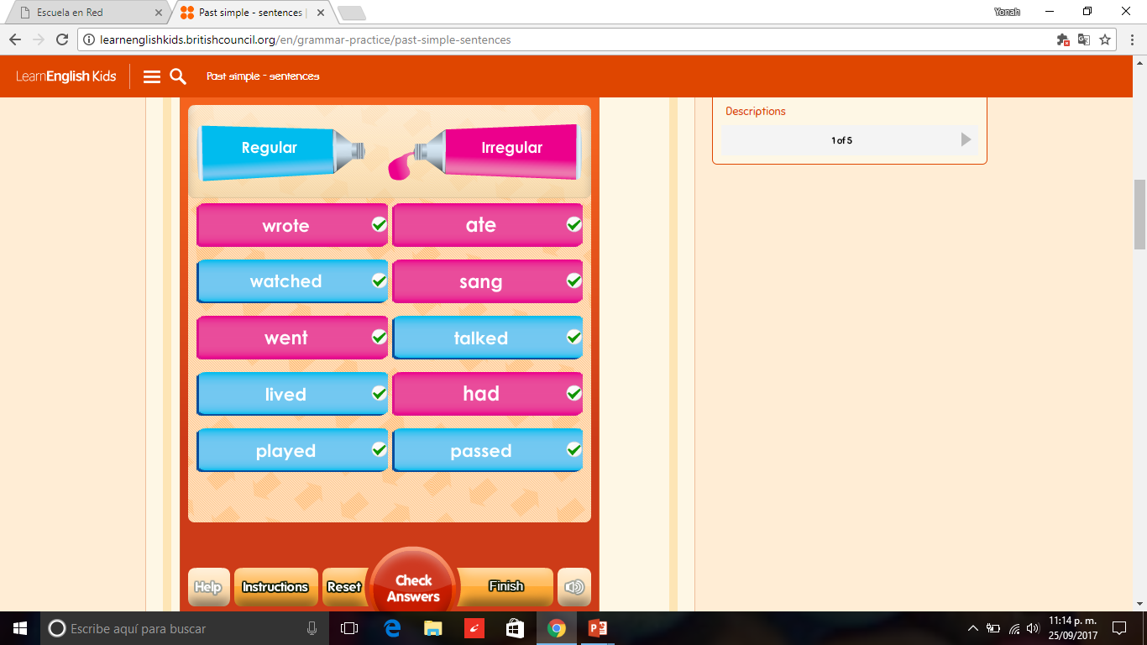
1) http://www.eslgamesworld.com/members/games/grammar/New_Snakes_%20Ladders/Past_simple_tense.html
2) http://learnenglishkids.britishcouncil.org/en/grammar-practice/past-simple-sentences

Slide 5
