Slide 1
You Played
You didn’t play
Did you play?
He Played
He didn’t play
Did he play?
She Played
She didn’t play
Did she play?
It Played
It didn’t play
Did it play?
We Played
We didn’t play
Did we play?
You Played
You didn’t play
Did you play?
They Played
They didn’t play
Did they play?

Slide 2
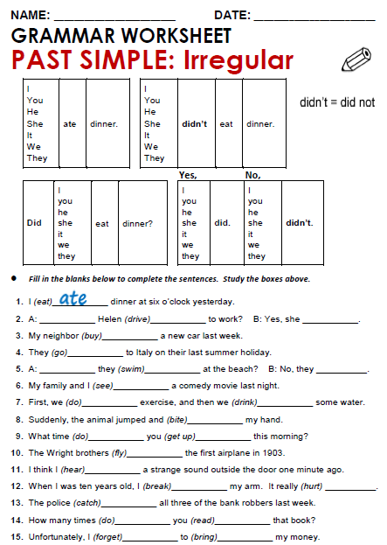
Did
drive
did
bought
went
Did
swim
Didn’t
saw

Slide 3
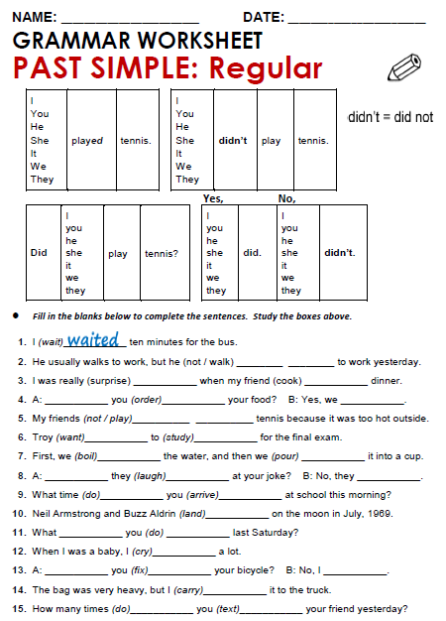
Didn’t
walk
surprised
cooked
Did
ordered
Did
Didn’t
play
wanted
studied

Slide 4
Practice simple past of irregular, possitive, negative and questions
http://www.eslgamesworld.com/members/games/grammar/New_Snakes_%20Ladders/Past_simple_tense.html
http://learnenglishkids.britishcouncil.org/en/grammar-practice/past-simple-sentences

